Slide 1
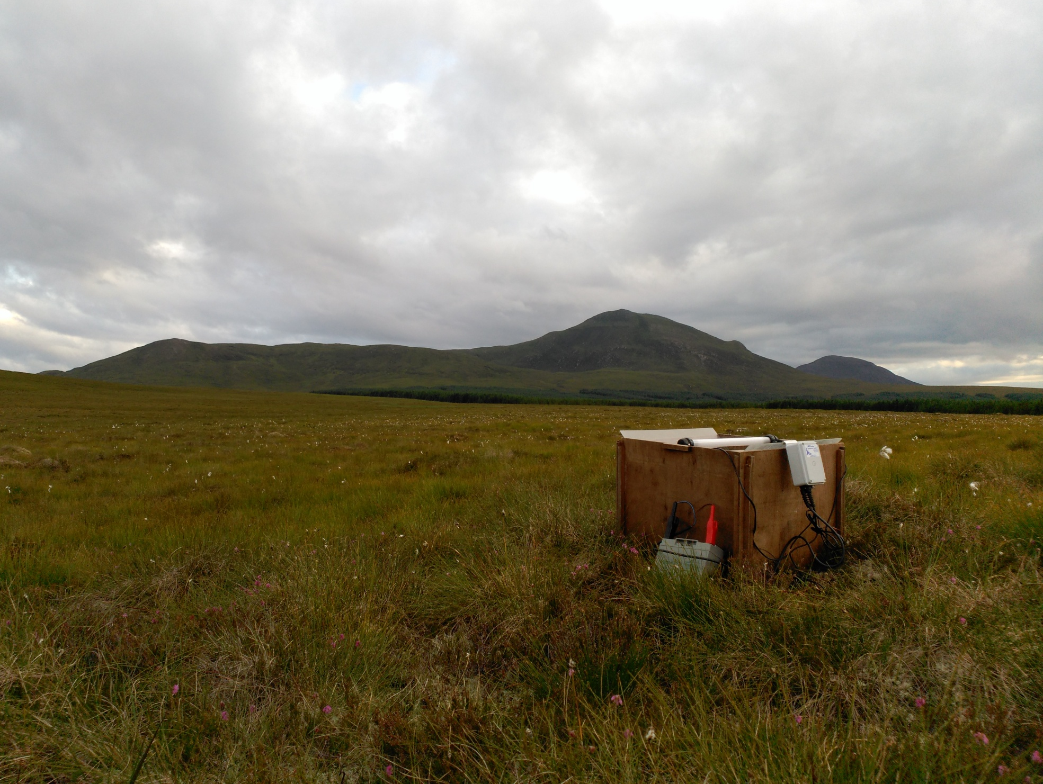



CARABID beetles
IN PEATLAND RESTORATION
Ainoa Pravia
Dr Roxane Andersen, Dr Rebekka Artz
Dr Kenneth Boyd, Dr Nick Littlewood

Slide 2
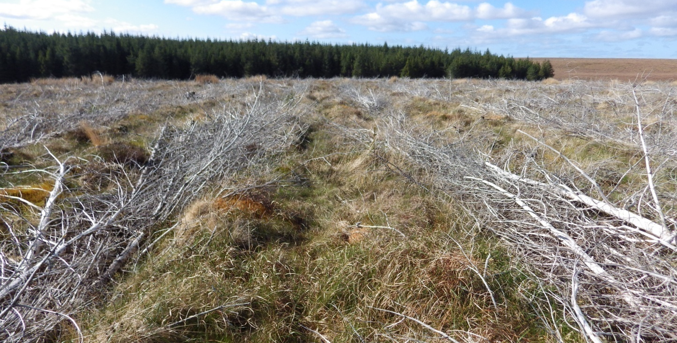
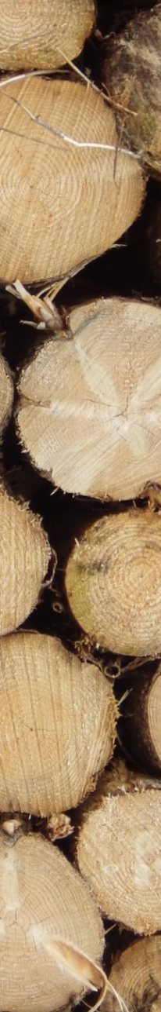
Forest to Bog Restoration
Restoration of afforested blanket bog (FtB)
Different techniques trialled in Forsinard
Chronosequence focuses on felled to waste

Slide 3
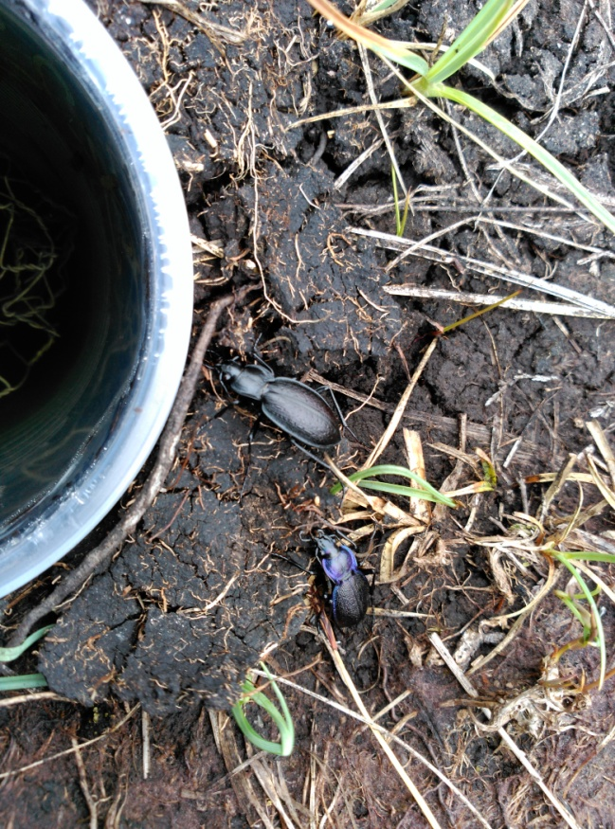
Experimental Aims
What type of restoration trajectory can we expect for carabid communities? What environmental variables best predict carabid distribution?
Do carabid functional traits follow a similar trajectory? What environmental variables are of importance for functional traits?
Notes:
Examine how invertebrate/carabid assemblages change throughout the restoration gradient and what environmental variables best predict such changes.
Investigate what environmental variables may have an influence on the trajectory of carabids/carabid functional traits following peatland restoration.

Slide 4

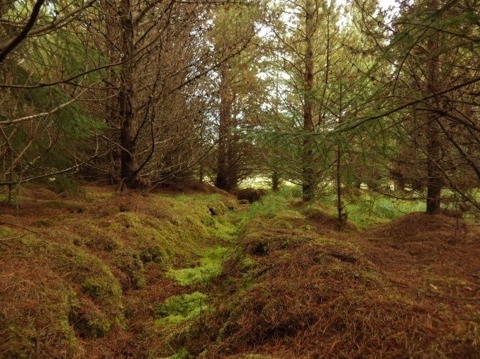
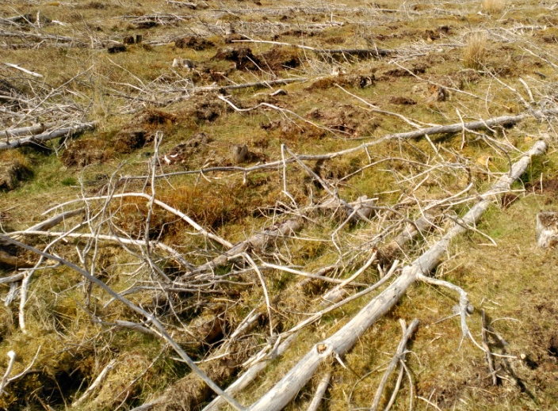
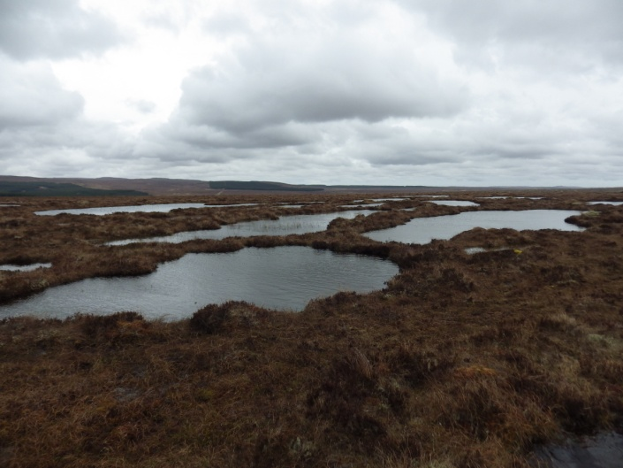
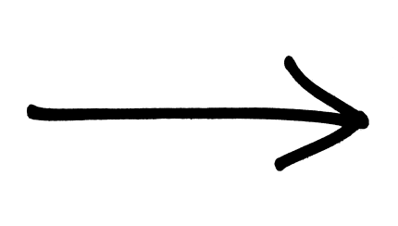
Chronosequence
Forest
Restoration
Bog
Notes:
Here we can see the treatments present in the chronosequence. As one can expect, we start off in a coniferous plantation that once is felled it becomes a restoration site, and then after a number of years it becomes again the original bog that it once was. That is actually pretty utopic, we know that is difficult to completely restored things the way they were, but obviously in this situation we have to take into account what the original targets and expectations of the restoration process are.

Slide 5
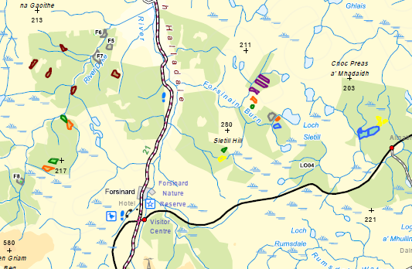
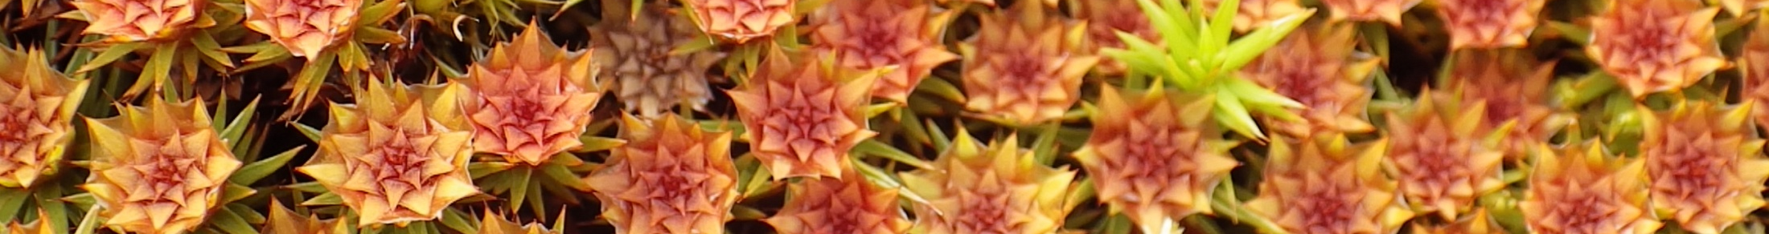
Pitfall Trapping
Treatments:
Forest
Bog ( )
Restoration
  18 years
  13 years
  12 years
  11 years
  10 years
  2 years
Notes:
Idea of scale at Forsinard: about 17km in a straight line from B8 to RA03
Randomised block design – I have 6 different restoration ages spanning from 2 years to 18 years, each of them with 4 replicates; and 5 replicates of bog and forest.

Slide 6
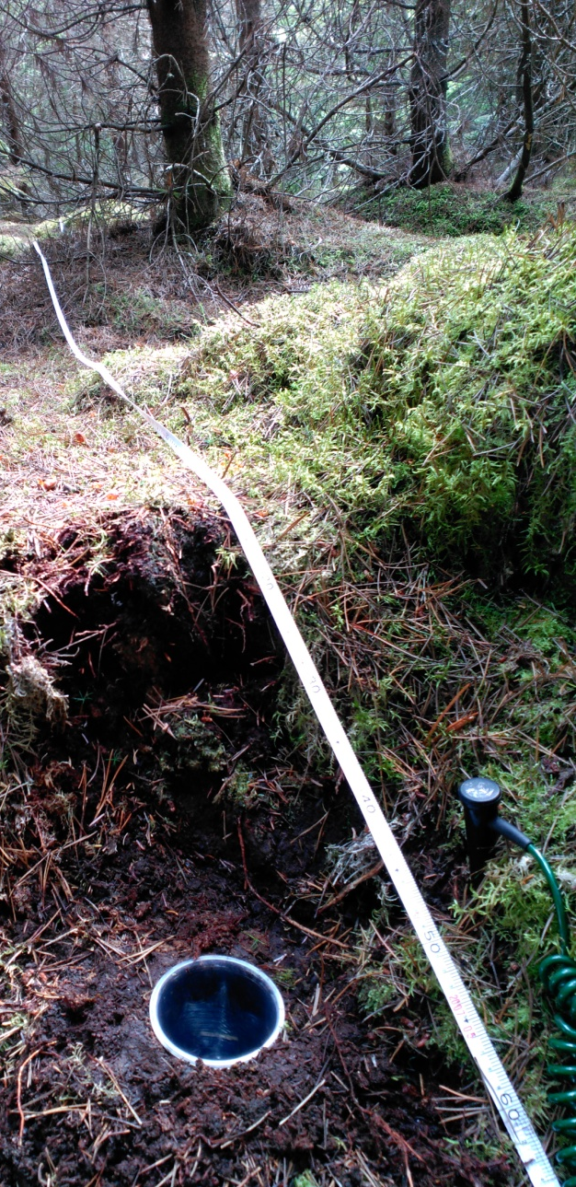
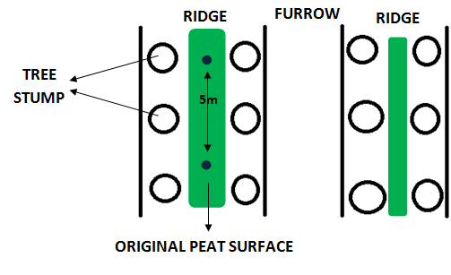
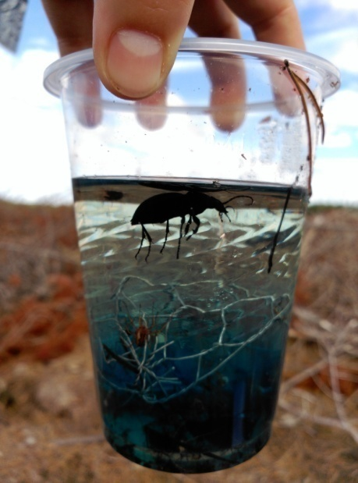
Transect Arrangement
Notes:
The transects were arranged in traps of 4. the traps are 50ml Tesco plastic cups, and were position as the diagram shows on the original peat surface that remains on both forest and restoration at the top of the ridges. Transects didn’t necessarily follow ridges, a protocol was design on how they were set up. All traps were set 5m apart from each other in the way you can see in the pictures, and were filled with circa 10ml of ethylene glycol as a preservative and killing agent.
816 traps

Slide 7
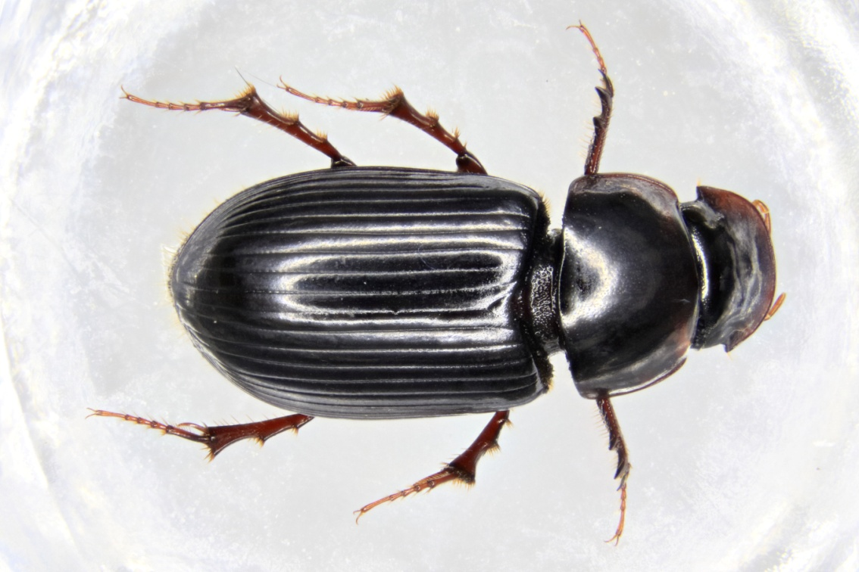
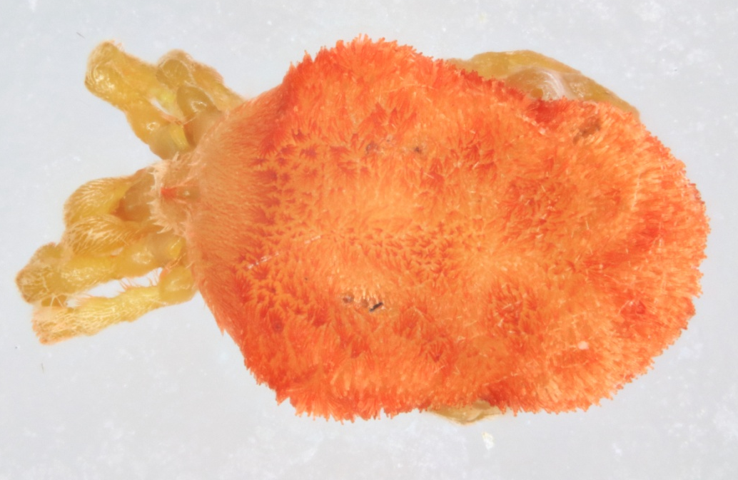
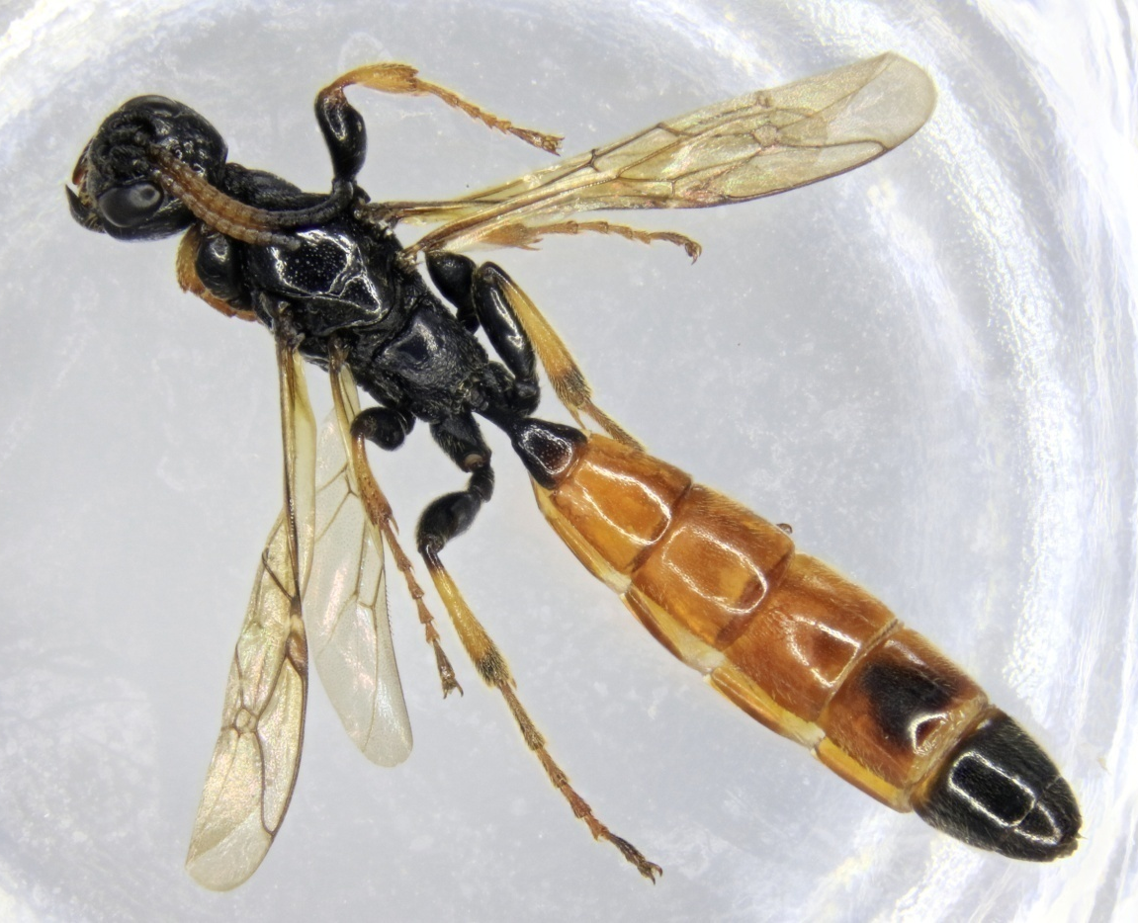
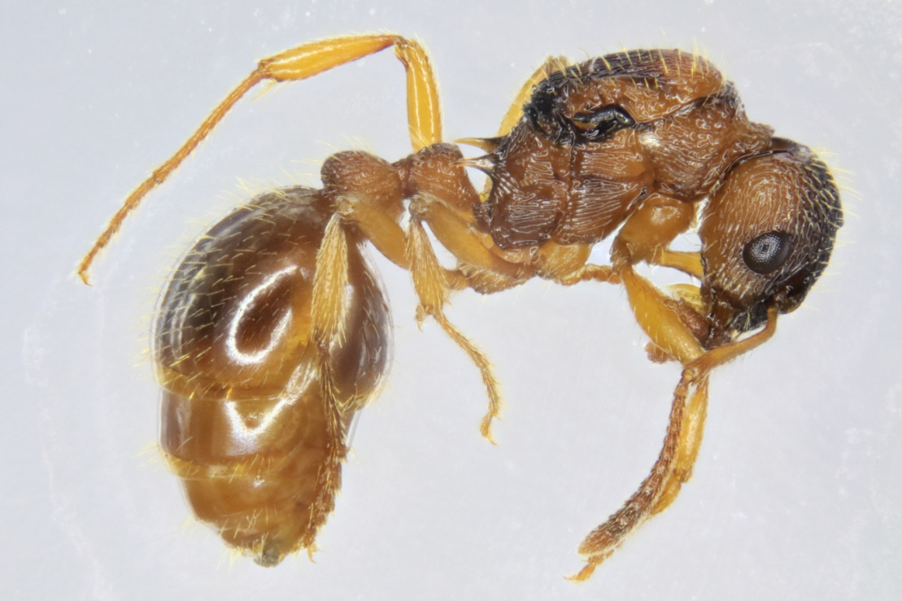
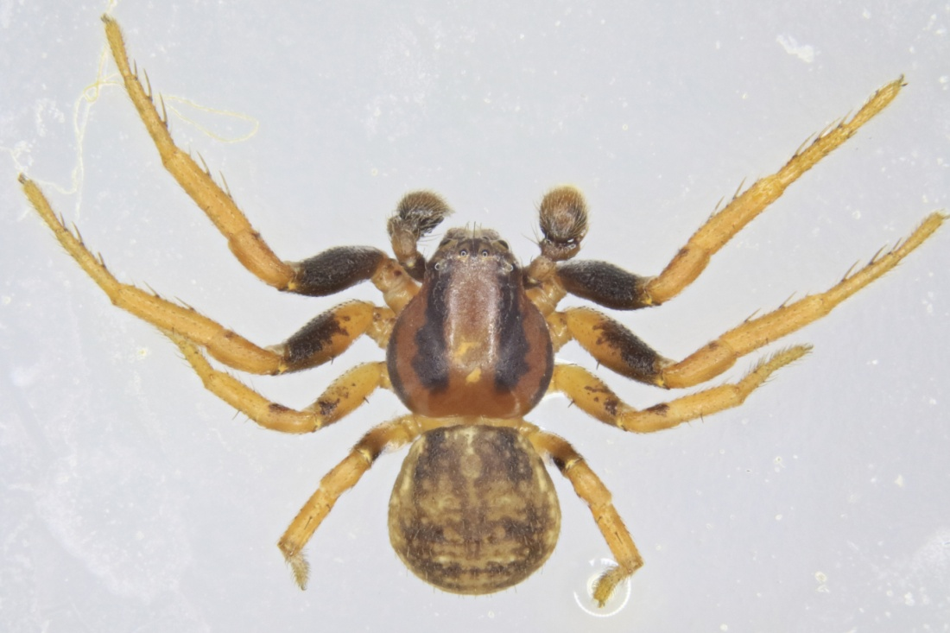
Invertebrate Diversity
P. Arthropoda
P. Mollusca
P. Annelida
P. Chordata
F. CARABIDAE
Carabus glabratus
Carabus problematicus
Cychrus caraboides
Dyschirius globosus
Pterostichus adstrictus
Pterostichus niger
Pterostichus diligens
Notiophilus biguttatus
Notiophilus germinyi
Leistus terminatus
Loricera pilicornis
Nebria salina
Patrobus assimilis
Pterostichus nigrita
Trechus obtusus
Agonum ericeti
Agonum fuliginosum
Amara lunicollis
Trechus rubens
Bembidion quadrimaculatum
O. COLEOPTERA
Carabidae larvae
Hydrophilidae
Leioidae (Catops sp.)
Staphylinidae
Proteininae
Hydraenidae (Limnebius sp.)
Silphidae
Nicrophorus vespilloides Nicrophorus investigator
Tanatophilus rugosus
Nicrophorus humator
Oiceoptoma thoracicum
Elateridae
Pselaphinae
Scydmaeinidae
Entiminae
Cantharidae
Dytiscidae
Cerambycidae
Curculionoidea
Monotomidae
Gyrinidae
Scarabeidae
Nitidulidae
O. SIPHONAPTERA
O. HETEROPTERA
O. HOMOPTERA
Auchenorrhyncha
Sternorrhyncha
Coccoidea (scale insect)
O. HEMIPTERA
Gerridae
Ortheziidae
Aphidoidea
O. HYMENOPTERA
Formicidae
Myrmica ruginodis
Formica fusca
Lasius niger
Ichneumonoidea
Symphyta O. COLLEMBOLA
O. PLECOPTERA
O. LEPIDOPTERA
O. DIPTERA
Nematocera
Tipulidae
Brachycera
SBP. MYRIAPODA
Chilopoda Diplopoda
C. GASTROPODA
Slug
Snail
C. OLIGOCHAETA
Earthworm
SBC. ACARI
Prostigmata
Bdellidae
Trombiculidae
Erythraeidea
Mesostigmata
Oribatida
Phthiracaridae
Damaeidae
Ixodidae
O. OPILIONES
Nemastoma bimaculatum
Mytopus mori
Araneae
Pseudoscorpiones
SBP. VERTEBRATA
Shrew
Newt
Toad
Frog
Lizard
Vole

Slide 8
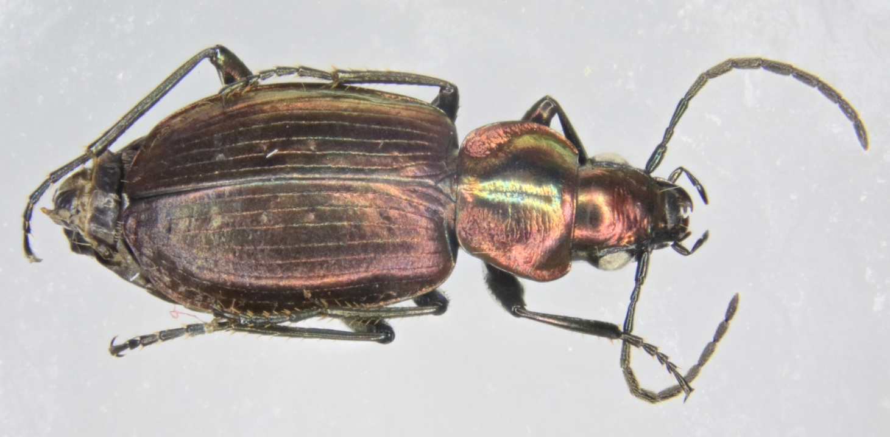
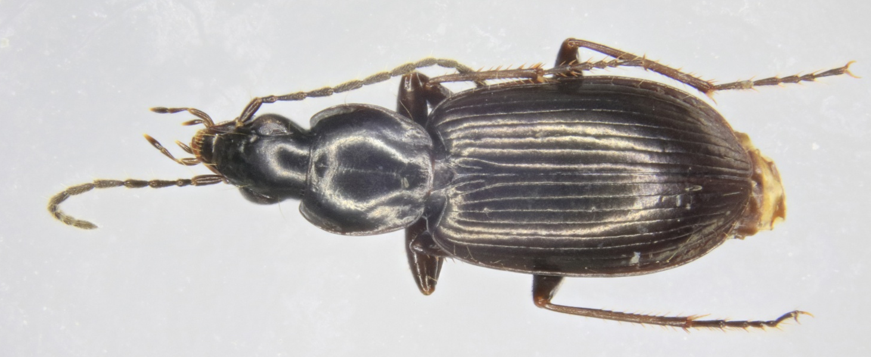
Agonum fuliginosum
Agonum ericeti

Slide 9
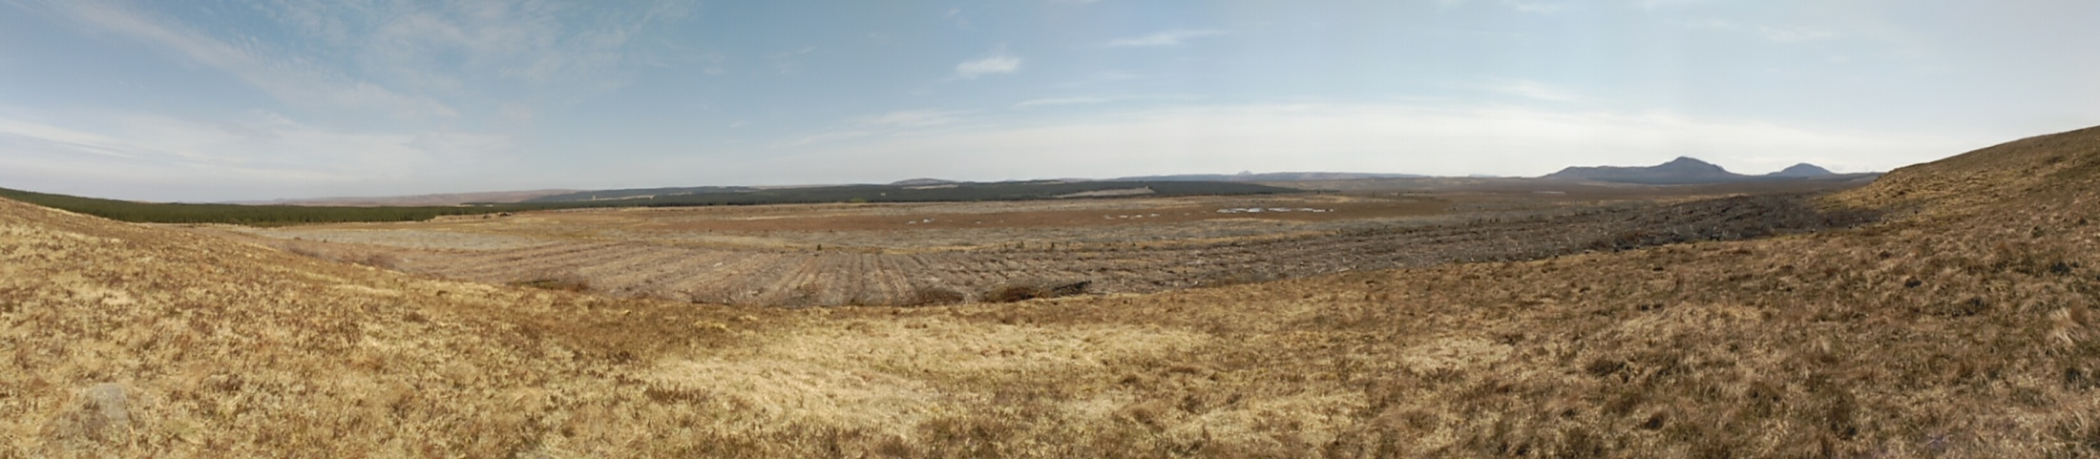
Preliminary Chronosequence Results

Slide 10
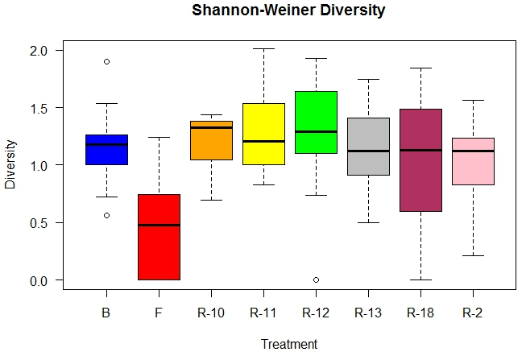
Taxonomic Diversity

Slide 11
RDA Carabid Assemblage
Total model inertia = 35% - 20% constrained; 14% unconstrained
1st Axis = 32.5%; 2nd Axis = 13%
Notes:
Bog species: CPRO, PNIGR, AER, AFU + AGE and BPEAT
Forest: TOB
Restoration: mix of all species really (R18 + SHRB & GRSED; all others + MOSS)

Slide 12
RDA CWMs
Total model inertia = 76% - 69% constrained; 7.3% unconstrained
1st Axis = 29%; 2nd Axis = 17%
Notes:
Treatment (factor) represents each level as a centroid
1st axis – NOR, BPEAT, TA, SHRUB
2ND axis – AGE (bog) and EAST (R11, R12, R13, R18)
Green circled traits occur more often in bogs at larger distances from road, higher temperatures, higher moisture
Orange circled traits occur more often within forest at larger distances from pools and lower PH
Brown circled traits occur more often in restoration at shorter distances from the road and lower temperatures, lower moisture

Slide 13
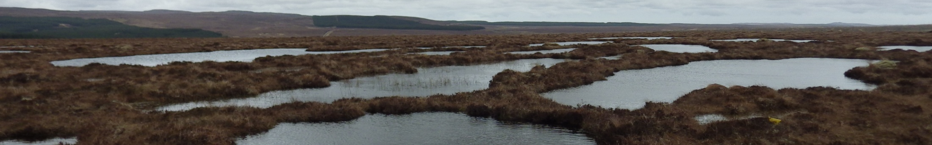
PRE-DISCUSSION
Clear definition of restoration objectives & targets
Differences in key variables for carabid species & carabid FTs
Potential for bioindicators

Slide 14
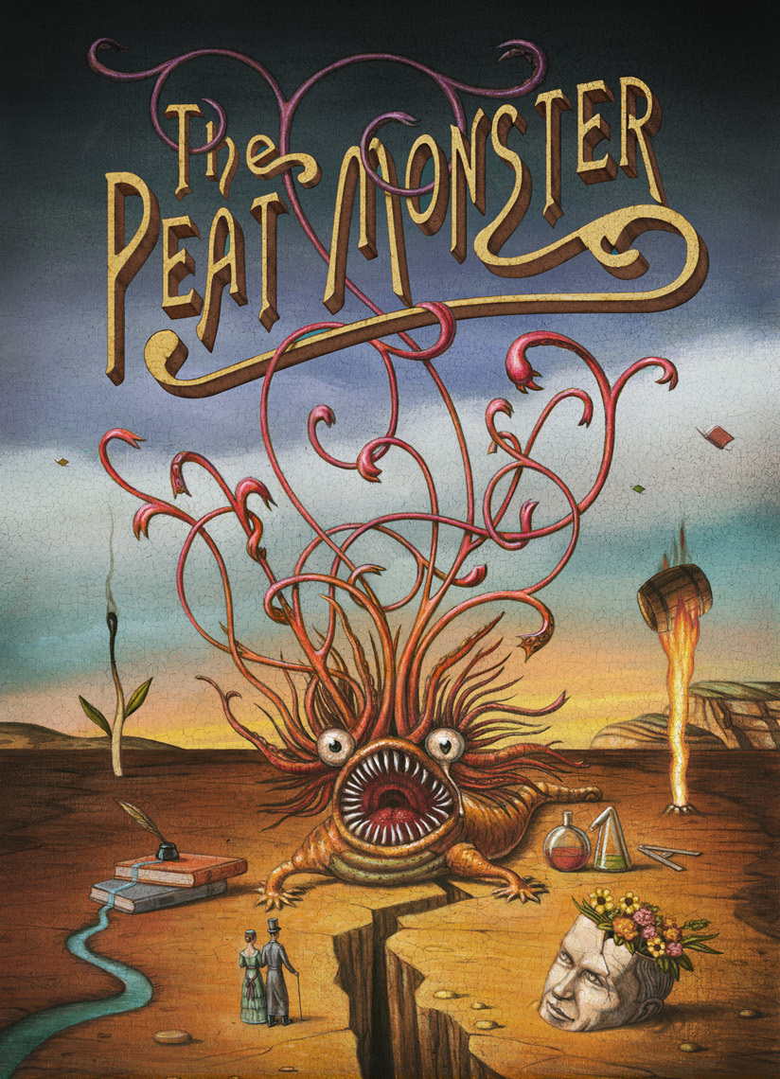


Thank You
Many thanks to:
David Braidwood (ERI)
Andrea Britton (JHI)
Paul Gaffney (ERI)
Peter Gilbert (ERI)
Mark Hancock (RSPB)
Daniela Klein (RSPB)
Ruth Mitchell (JHI)
Gabor Pozsgai (JHI)
Lucho Quinzo (JHI)
Chris Ross (Fountains)
Jenni Stockan (JHI)
Mark Telfer
Ashleigh Whiffins (NMS)
RSPB Forsinard
Bighouse Estate
... And many more!!
© Compass Box Whisky

