Slide 1
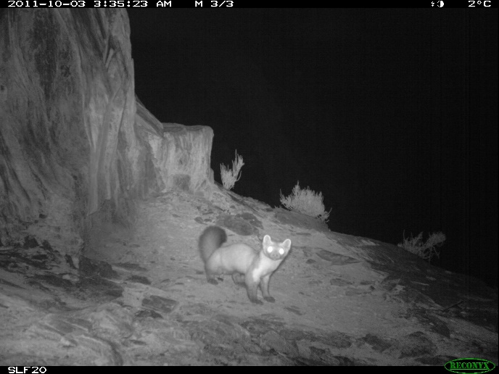
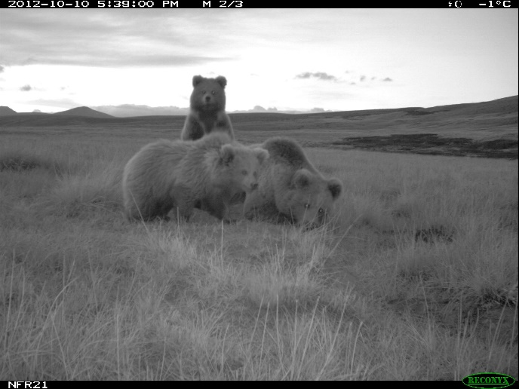
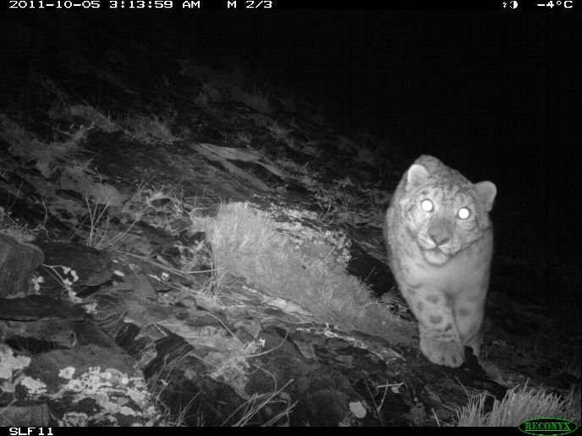
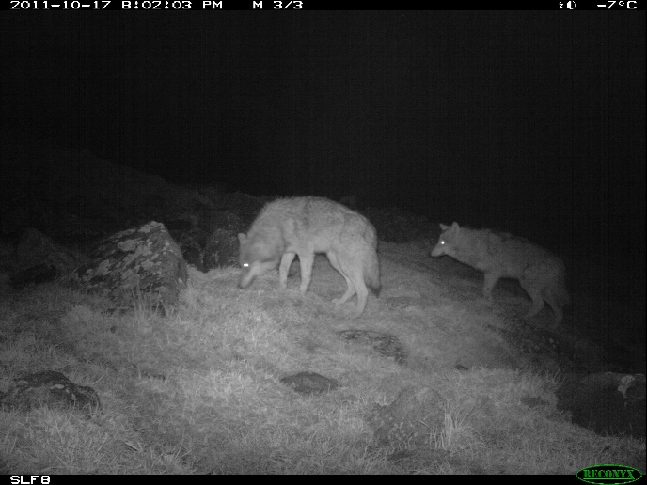
Revealing anthropogenic impacts on carnivore guilds using non-invasive monitoring: a PhD Plan Mahdieh Tourani

Slide 2
FLOW
Data
- Non-invasive sampling
Analytical approach
- Spatial Capture-Recapture
Study Objectives
Questions
Notes:
For the next 15minute, I am going to talk about non-invasive monitoring of carnivores in Scandinavia and central Asia, followed by our approach to analyse such data. I will continue by explaining my study objectives and I would be happy to answer, should you have any questions.

Slide 3
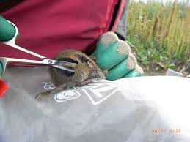
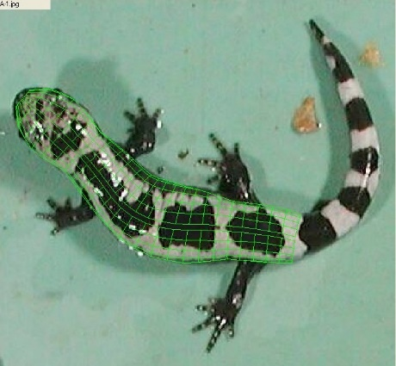
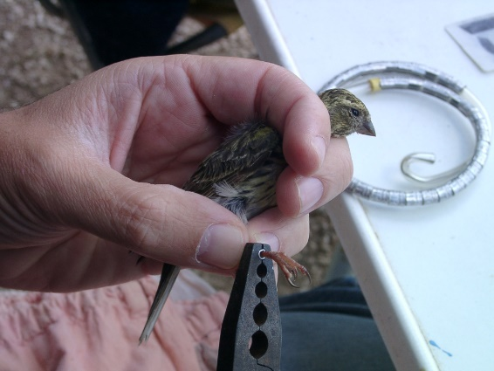
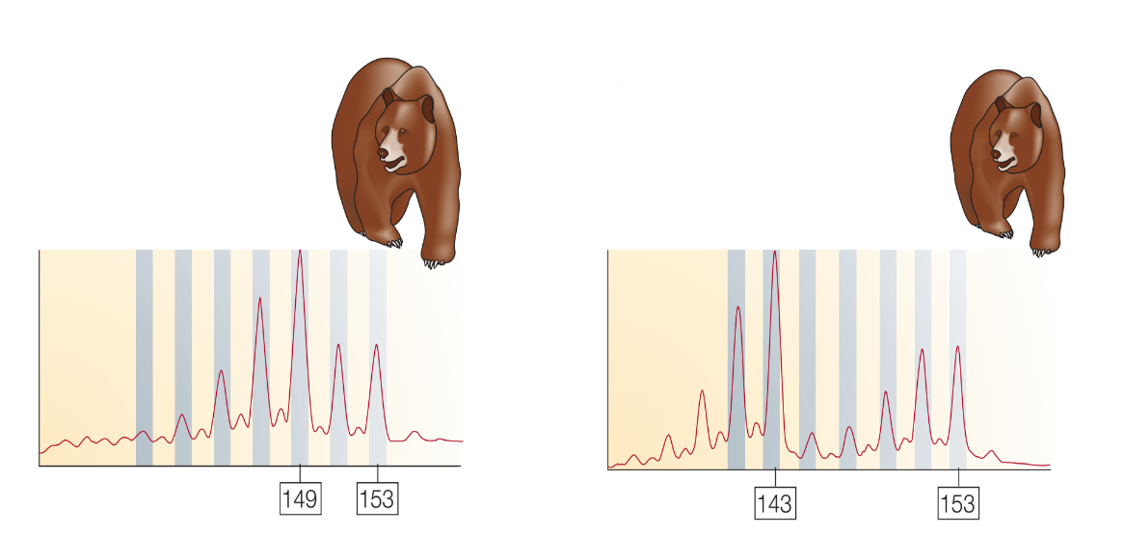
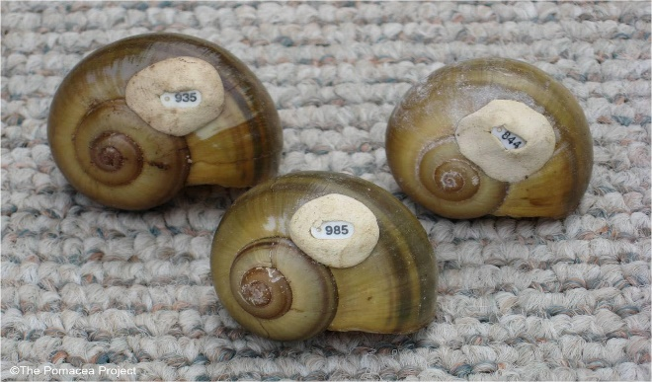
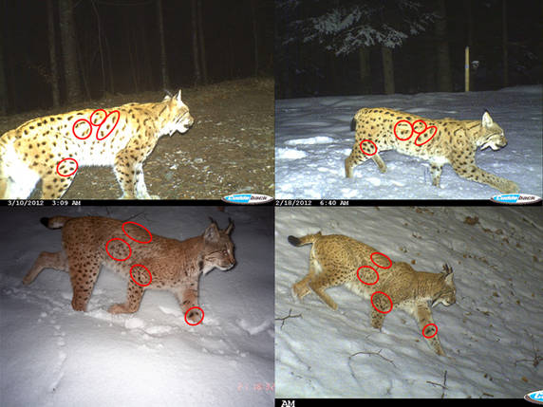
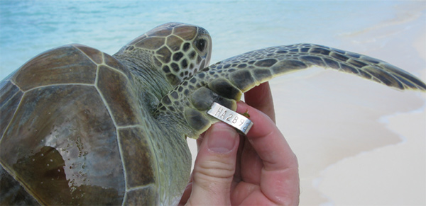
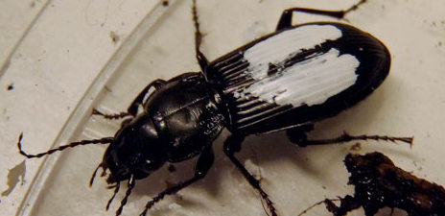
Modern Technology Helps Ecology: Non-invasive data, Hierarchical models
©NatureReviews|Genetics 2005
Notes:
New technologies produce vast quantities of ecological data. Previously, ecological studies mostly involved phisical handling, captureing, tagging and putting dye on individuals. More recently, you can obtain the same amount of information (sometimes even more information) by non-invasively collected data such as camera trapping and genetic sampling, from scat, hair, dead recoveries and so on.
From cemra trap photos you obtain
From DNA samples you get info e.g.

Slide 4
Modern Technology Helps Ecology: Non-invasive data, Hierarchical models
Species
Individual
Sex
Diet
Location (x,y)
Species
Individual
Sex
Age class
Location (x,y)
Notes:
In cemra trap photos you can distinguish between species, identify individuals based on natural markings, identify sex and age class.
From genetic finger-printing we can obtain the same information.
Very importantly, during ecological surveys, every sample has information about the location we sampled from. Retaining this spatial component about trap locations and therefore about individual encounter locations, enables us ecologists to address questions that were not possible to answer before.
We use this information to prepare spatial encounter histories, meaning detection of every individual at every trap in each visit occasion to proceed with analysis.

Slide 5
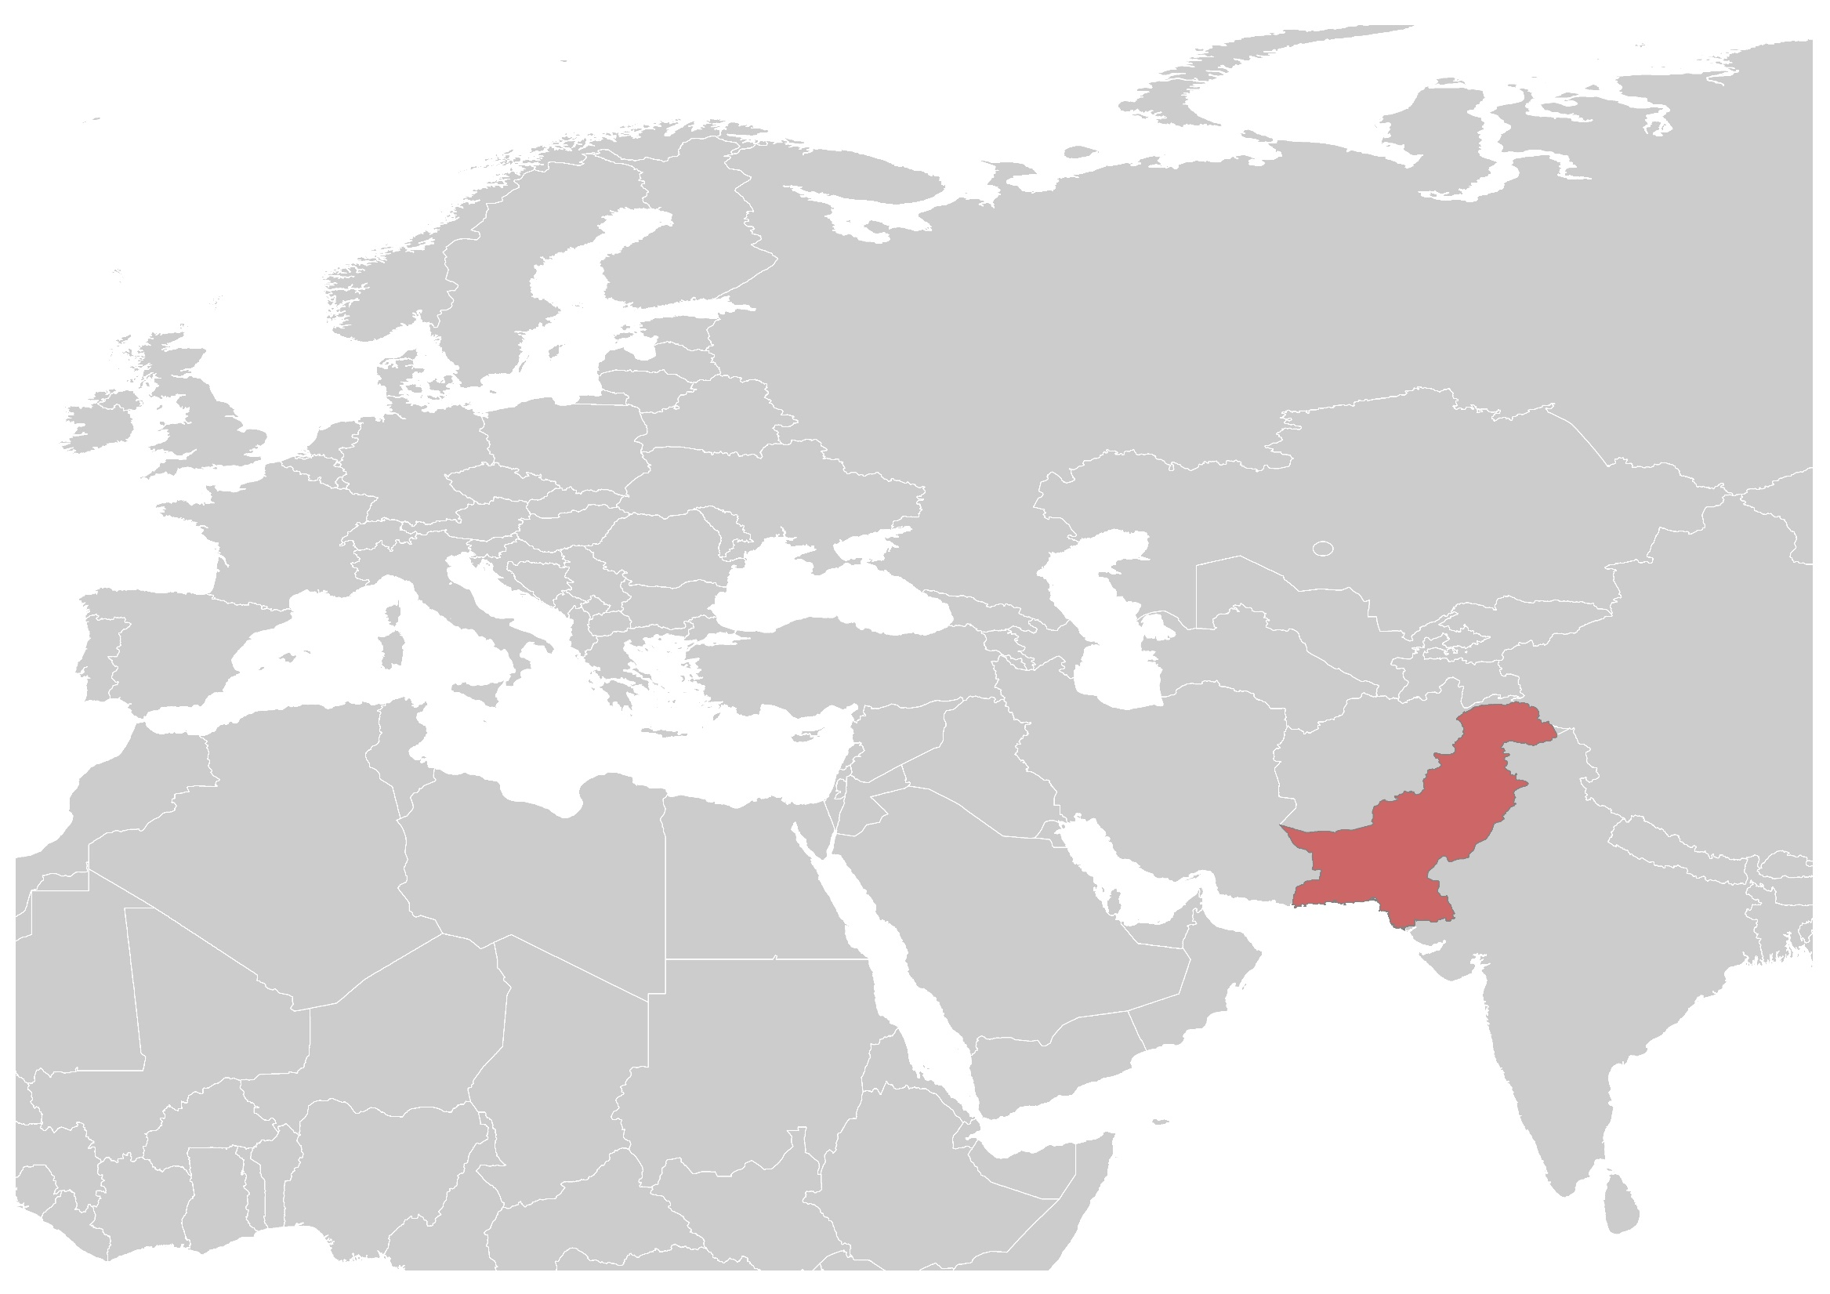
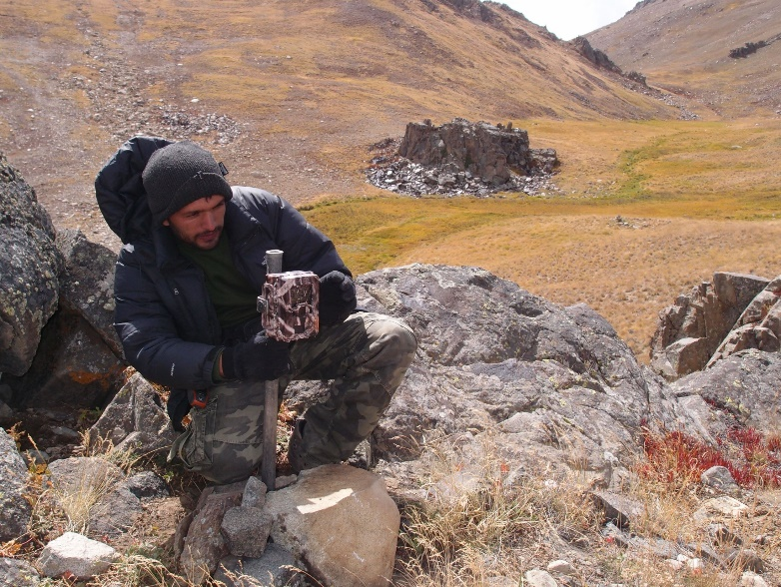
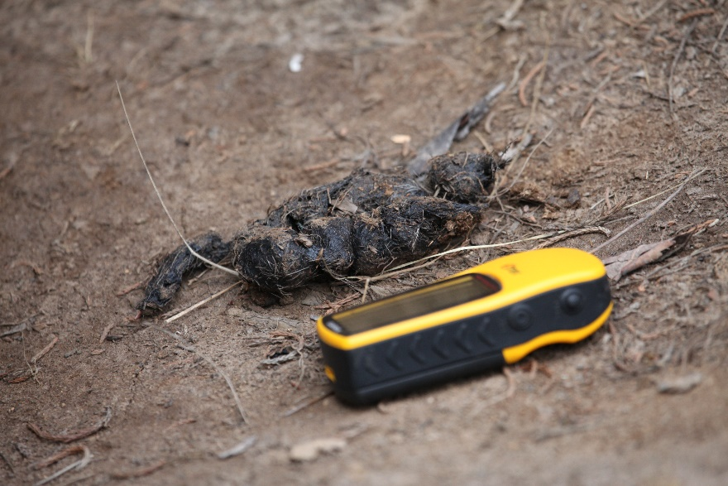
Gilgit
Notes:
I am analysing extensive data coming from two sources. The first data set is coming from Gilgit area in the north of Pakistan. We have about 7 000 photographic captures of 12 carnivore species, 1500 genotyped samples of 4 carnivore species (SL, RF, BB, GW)

Slide 6
Notes:
The second source of data for my PhD is the Scandinavian large carnivore monitoring data base. There are comprehensive non-invasive sampling data from bb, wolf and wolverine for more than one decade. And talking about numbers, there are >30 000 genotyped samples of 4 carnivore species from Scandinavia.

Slide 7
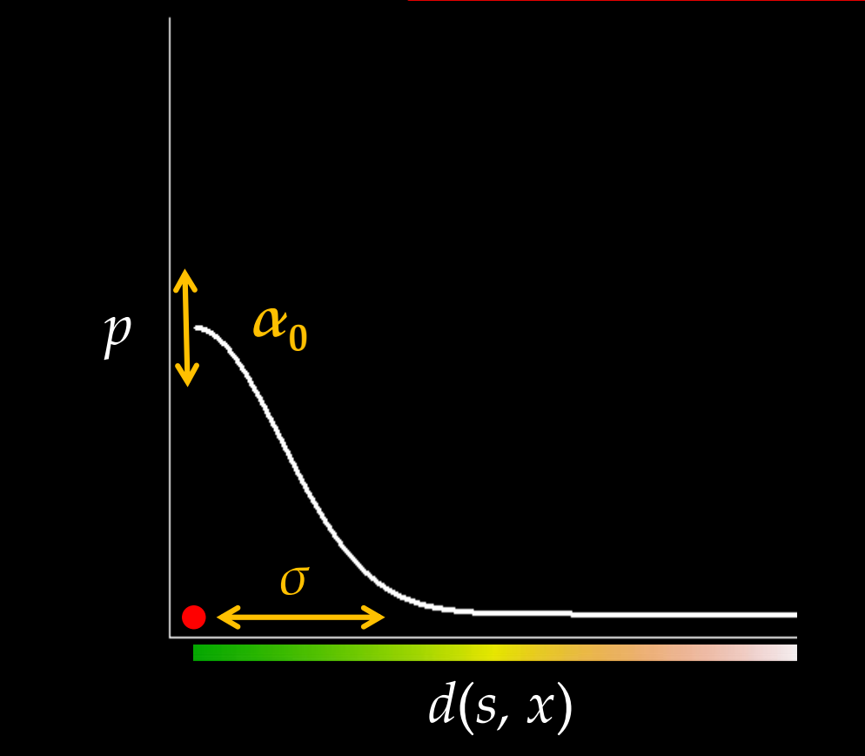
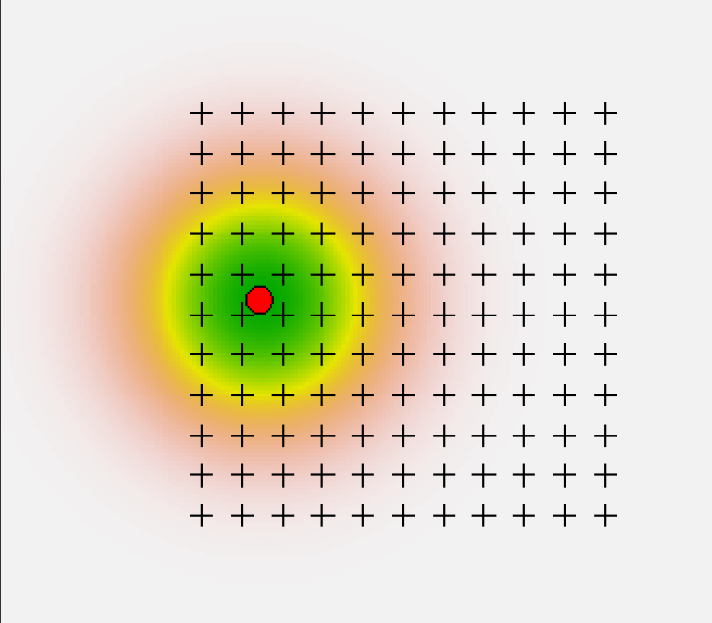
SCR: A Hierarchical CR
SCR Detection Probability Model
p(xj, si) = p0 * exp(- d(xj,si)² /σ²)
x: trap location
s: home range center
Biological Model:
State-space of point process
si ~ Unif(S)
+ Trap
Observation Model:
yij | si ~ Bern(p(xj,si))
Notes:
At the core of my PhD lie HM, mostly Spatial capture recapture. At one level, we model the way individuals are distributed in space through state-space of point process. But the underlying level is whether we detect the occurrence of individuals.
Biologically: Observations yi,j occur as a result of movement around a home range center and frequency of detection decreases with distance between trap and activity center si
Statistically: Observations yi,j are realizations of a probability distribution whose mean is a latent variable s i i.e. a random-effects model
A typical SCR data set consists of: • spatial locations of each trap – xj • individual-by-trap/location spatial encounter histories – yi,j
Further you go from an individual\s activity center, there\s less probability of detecting the individual.

Slide 8
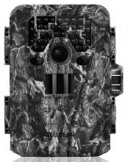
PhD Overview
POPULATION SIZE
HOME RANGE SIZE
MOVEMENT PATTERNS
Hierarchical modelling
SCR
Bayesian Framework
INTER-SPECIFIC INTERACTION
PATTERNS OF INDIVIDUALS’ DISAPPEARANCE
Notes:
In my PhD, I will apply modern hierarchical models for gaining ecological knowledge about carnivores.
In a series of five methodologically and conceptually connected studies, I will test for and quantify three globally important drivers of anthropogenic impacts on carnivore guilds: barrier effects through transportation networks, disturbance through human presence in the landscape, and illegal hunting.
So, my PhD is a two-fold study: not only to understand the extent and context-specificity of aforementioned effects on carnivores guilds, but also showcase how non-invasively collected data can be used to yield answers to a wide range of applied ecological questions.

Slide 9
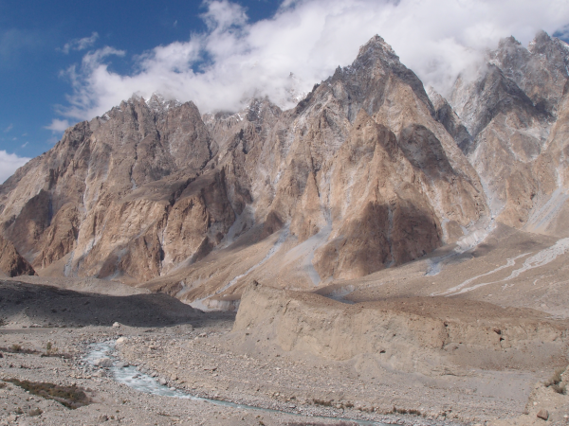
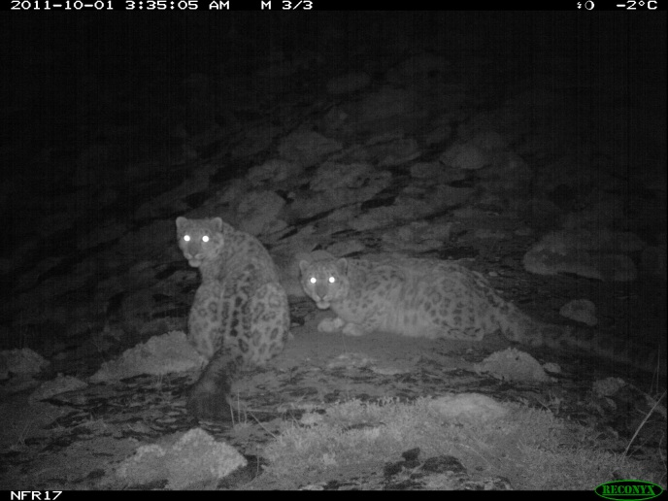
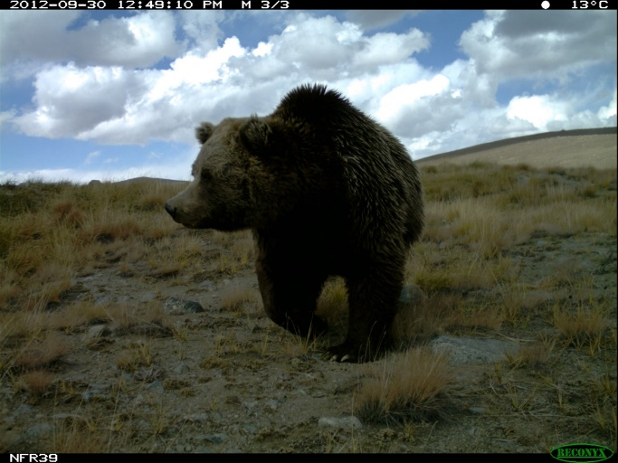
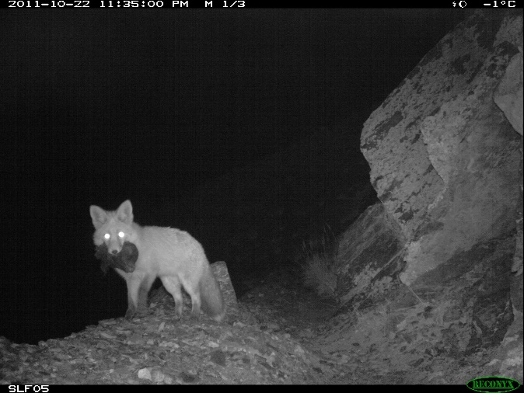
1. Incorporating multiple sources of data with different levels of info.
Notes:
In the first Q, we focused on using the best out of ecological data. The idea here is to develop a model to combine not only different sources of info (ct and dna) but also to integrate data with different amount of information. For example, we have identified individuals based on DNA samples, but some of our samples have not been genotyped compeletely to identify individuals. So, we have some samples that have individual id and some that don’t. Or, for camera trapping, we have handful of photos from naturally unmarked species e.g. RF, BB that cannot identify individuals based on camera trap.
Many of these data are being collected simultaneously during wildlife surveys and their combined use may provide a more complete picture of underlying ecological processes. Here we attempt to quantify the benefits of including additional sources of information into hierarchical ecological models in a methodological study that will be a pre-cursor to the remainder of the PhD.
The violin plot shows changes in distribution of para est bb population size, when including additonal sources of info in hm. Bb in deosai plateau in 2012, Pakistan.
The study can be rounded out by simulations and modeling to systematically establish how and under what conditions additional sources of information aid estimation of ecological parameters in integrated hierarchical models.

Slide 10
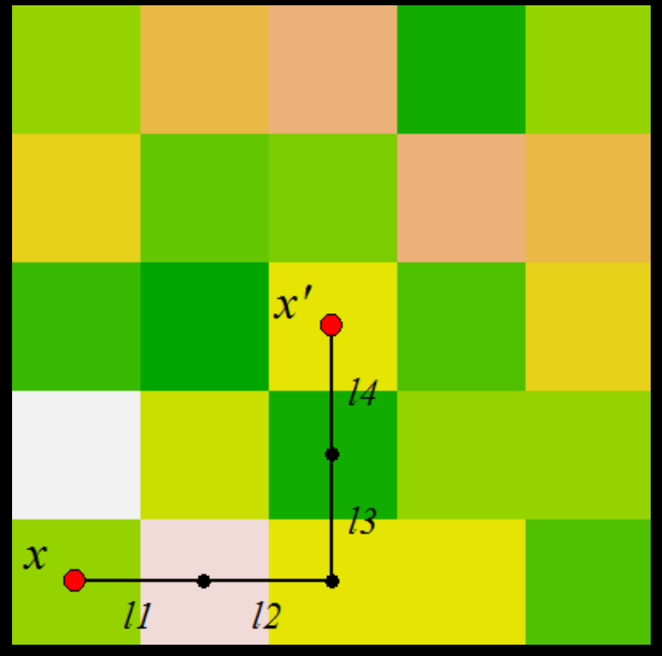
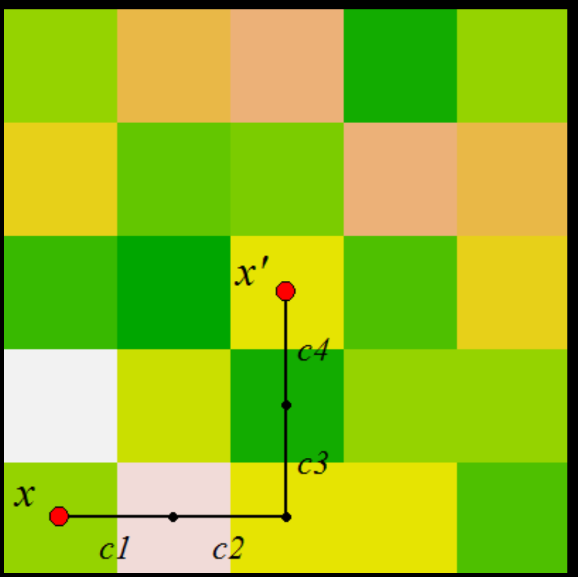
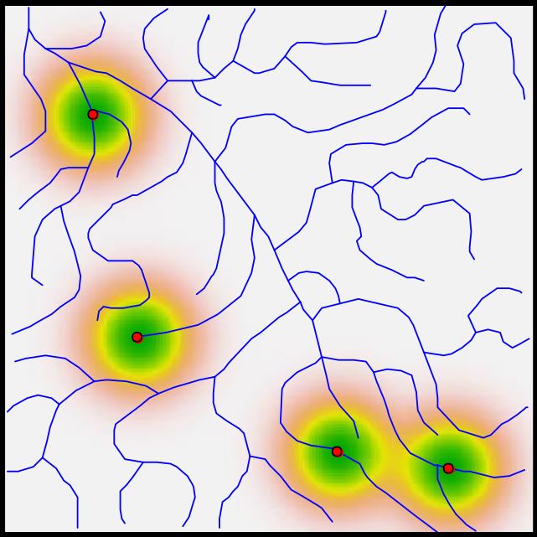
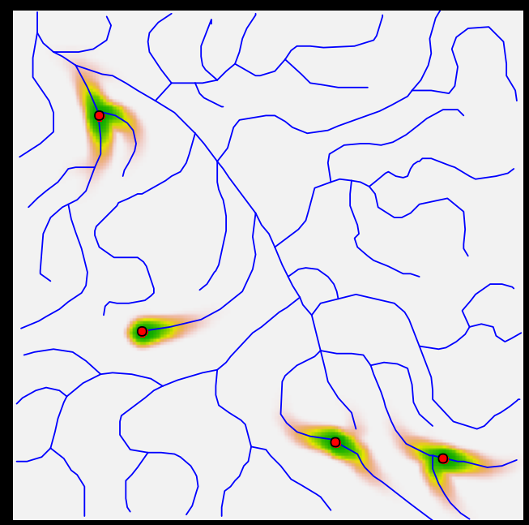
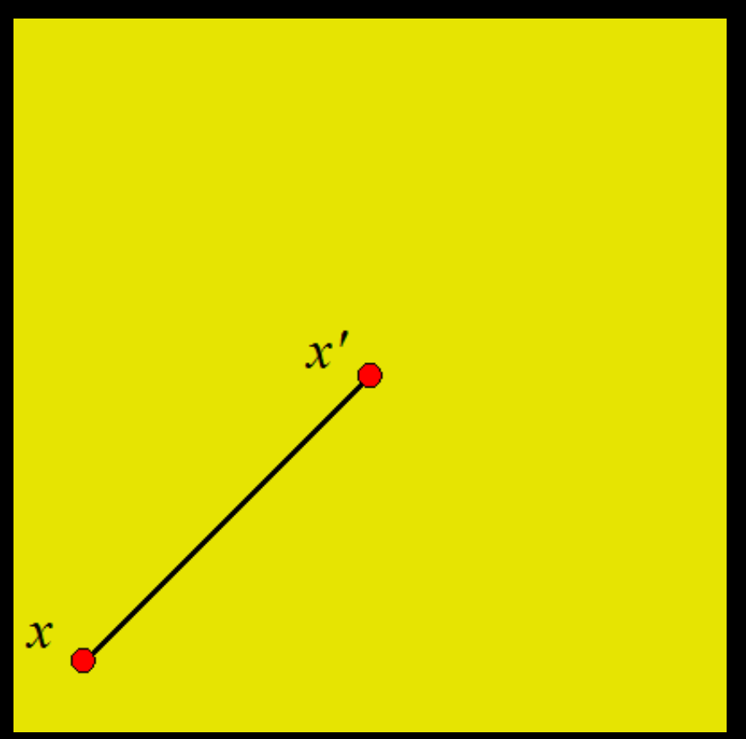
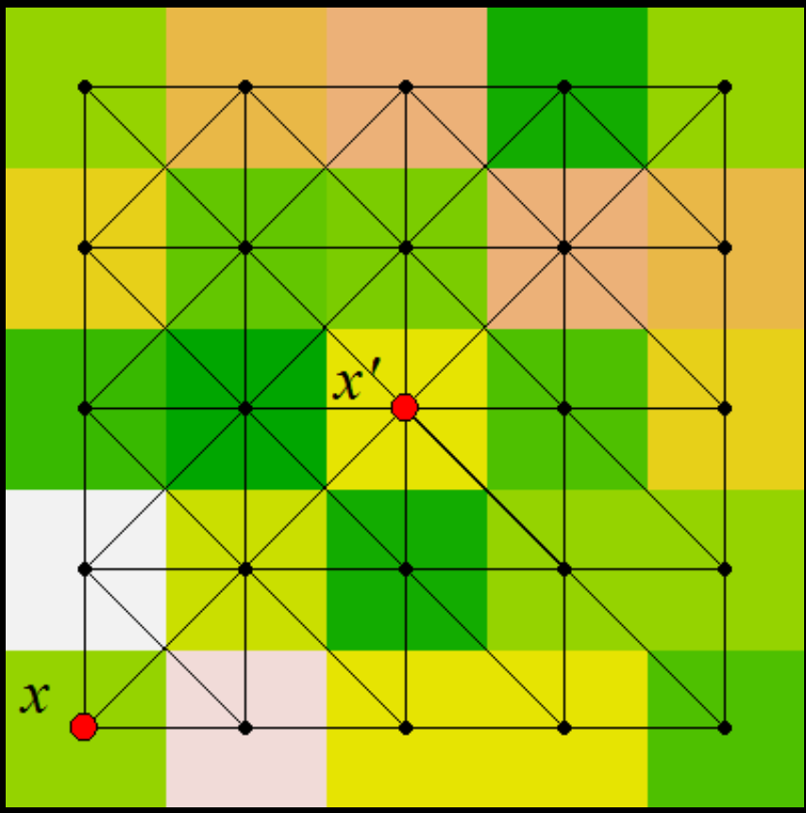
2. Home range size and geometry
‘Cost weighted’ distance vs Euclidean distance
Notes:
SCR originated as a technique for estimating density, but it also incorporate home-range information implicitly via a spatial ‘detection function. The detection function describes the declining probability of detection with increasing distance between an animal’s home-range centre and a particular detector. Recaptures of individuals across multiple detectors tend to be clustered spatially on the scale of home ranges, and this clustering provides the information needed to fit the SCR model and estimate home range attributes, even though the centres themselves are unknown.
Movement is not equally likely through all habitats, so the distance between two points is not necessarily Euclidean distance (straight line), rather, there are different ways of calculating distance. We model movement as there is a resistance/cost to movement between points. Also, we test different detection functions to model space use patterns of our target species in the landscape.
Measures of space use based on NGS in SCR has advantages over telemetry data, besides logistic constrains, estimation is based on a population-wide sample and can include adjustment for sampling biases, and estimates are accompanied by estimates of precision, density and sampling covariances such as topography and rivers and landscape features.

Slide 11
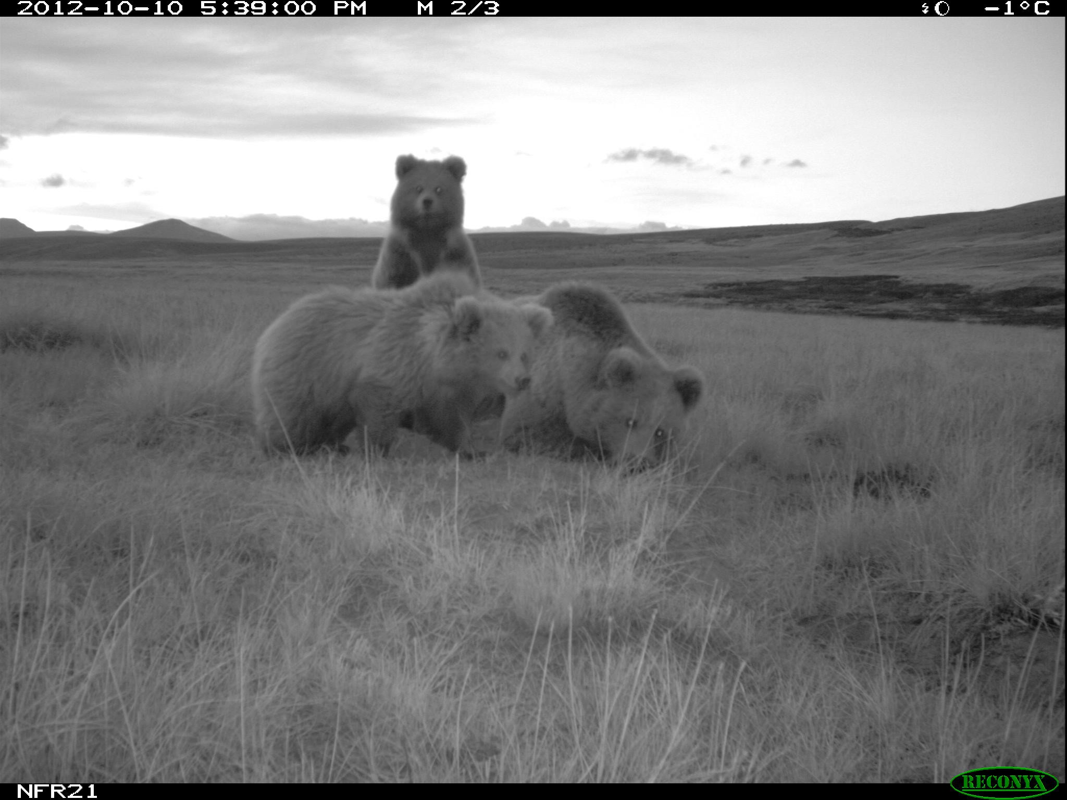
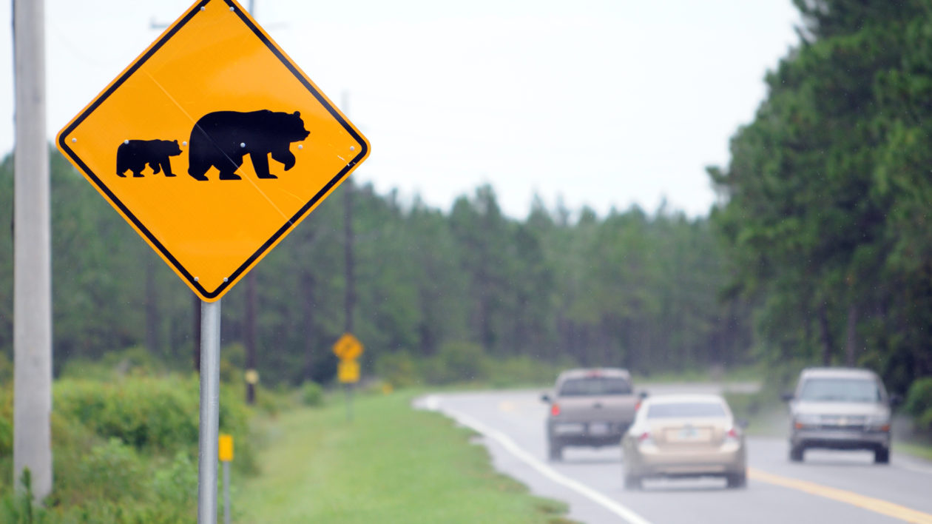
3. Effects of natural vs anthropogenic barriers to movement
Notes:
As the third study objective, I’d like to quantify and compare the relative contribution of anthropogenic and natural barriers to contemporary fragmentation in large carnivore populations.
We use species-specific resistance to movement maps across landscape to assess the role of fragmentation effects.
Can also contrast the magnitude of barrier effects of anthropogenic structures with those of natural barriers, such as mountain ridges and rivers/streams.

Slide 12
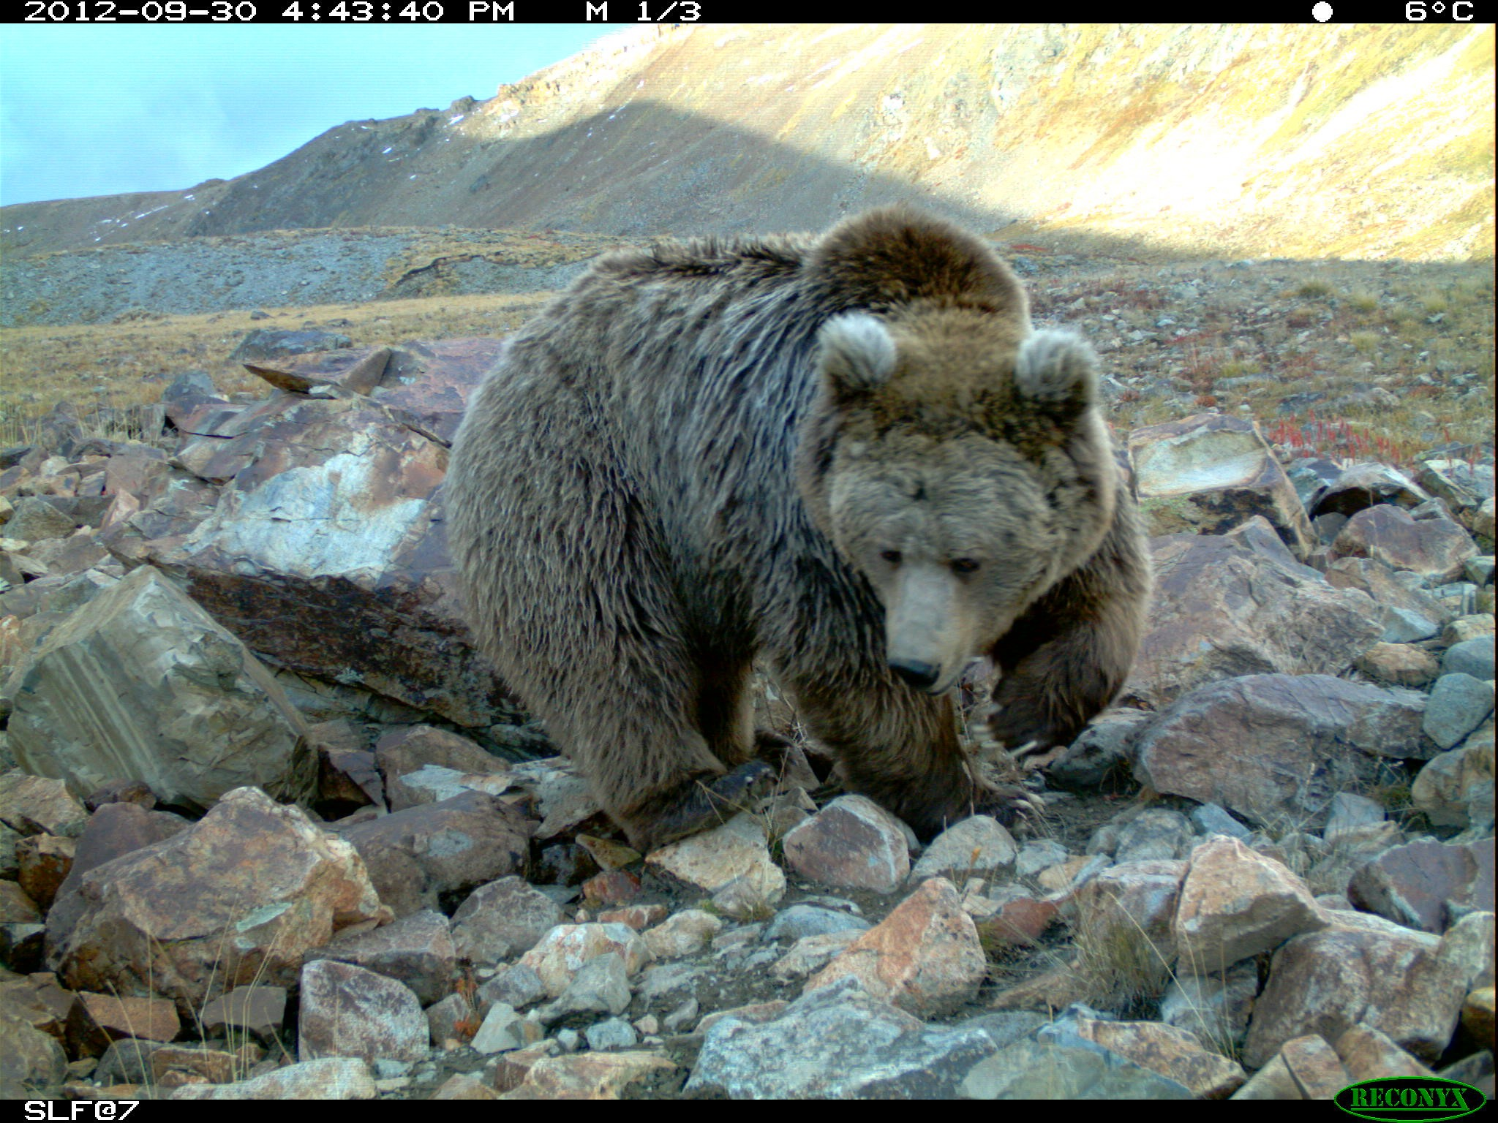
4. Identifying potential hotspots of illegal hunting
Notes:
Spatial and temporal patterns in disappearances of large carnivore individuals are quantifiable and may point at potential hotspots of illegal activity.
We use Scandinavian data and search for irregularities within the pathways that lead to the various apparent states and disappearances of large carnivores to identify potential hotspots of illegal hunting.

Slide 13
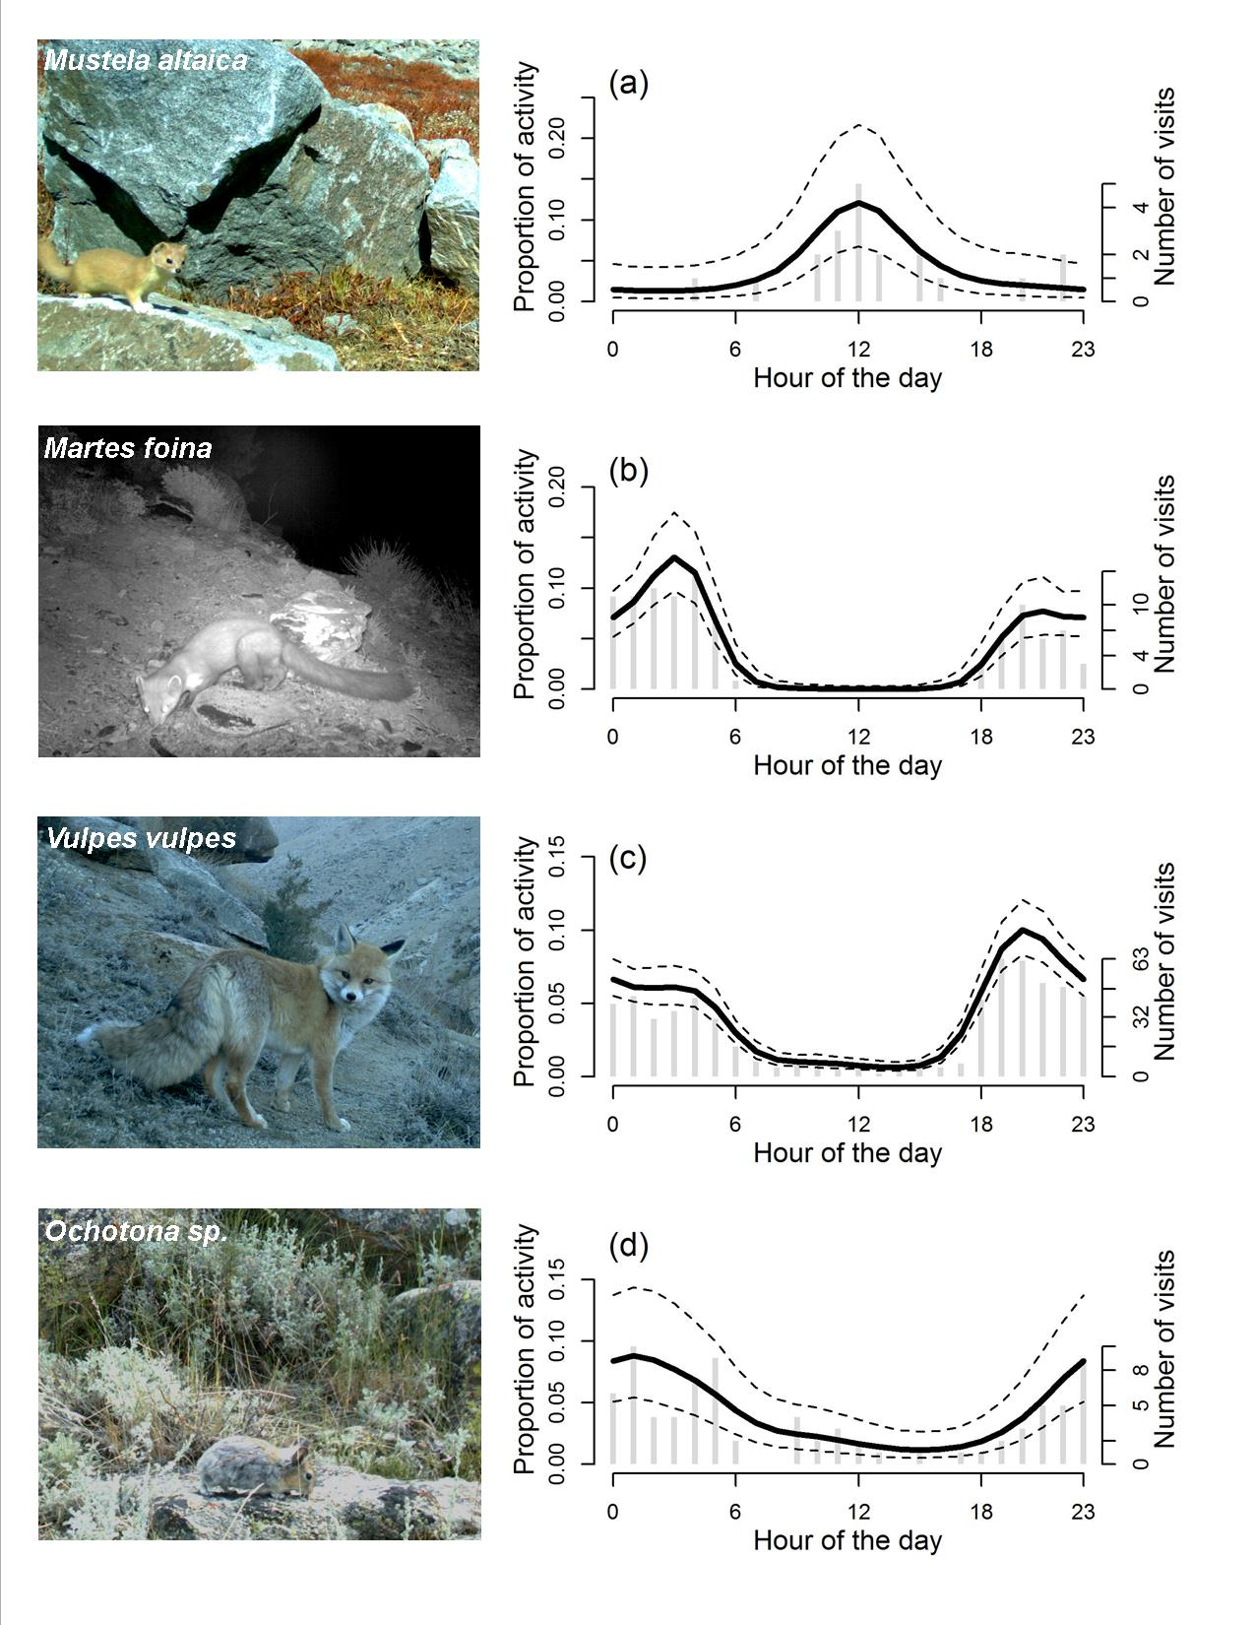
5. Intra-guild interactions: carnivore responses to human activity
Bischof et al. 2014, Journal of Zoology
Notes:
Studies on species interactions generally attempt to assess co-occurrence or avoidance separately, thereby potentially missing the actual interaction dynamic, which likely takes place across space and time jointly, not only one or the other.
We will test hypotheses about carnivore responses to human activity, evaluated in the context of intra-guild interactions between species of different body sizes and dominance.

Slide 14
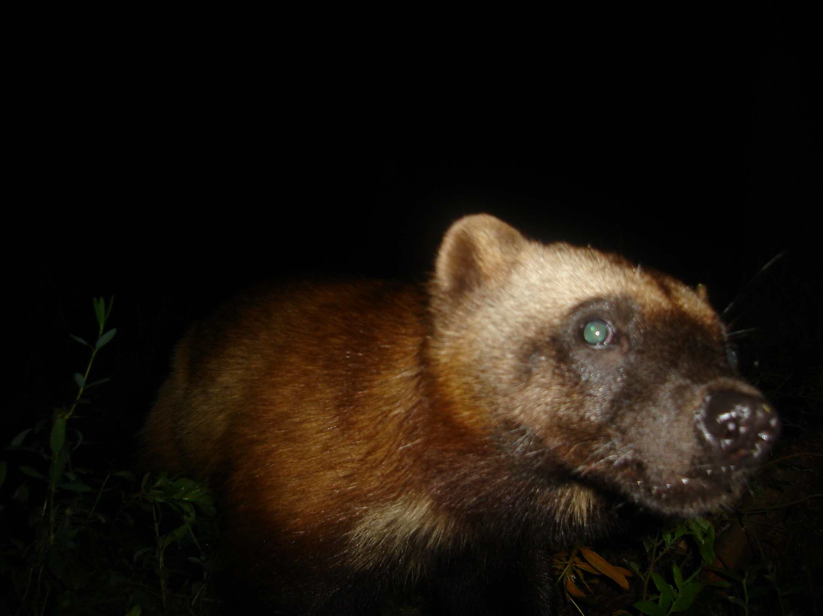
Notes:
This is my last slide. Thank you for listening.

