Slide 1
Ethiopia
How dominant tree species abundance relate with biotic, abiotic and disturbance factors in a dry Afromontane forest, Northern Ethiopia?
Mekdes Ourge

Slide 2
Introduction
Objectives
Data collection
Findings
Implication
Conclussion

Slide 3
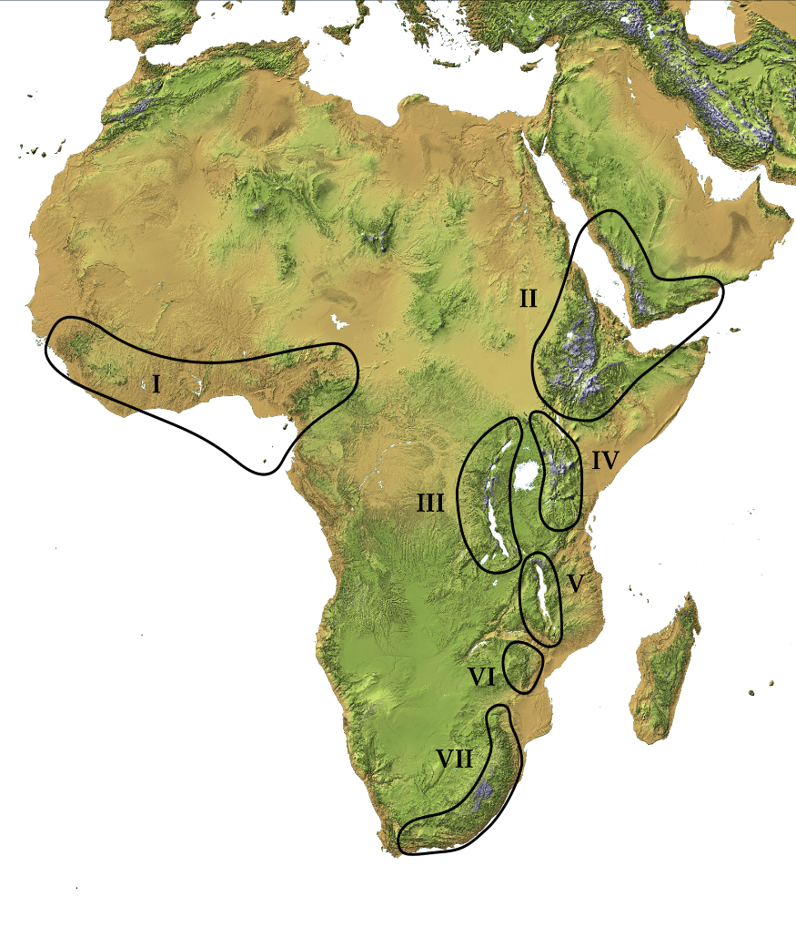
Dry Afromontane forest distribution
Different plant composition
Characteristic tree species

Slide 4
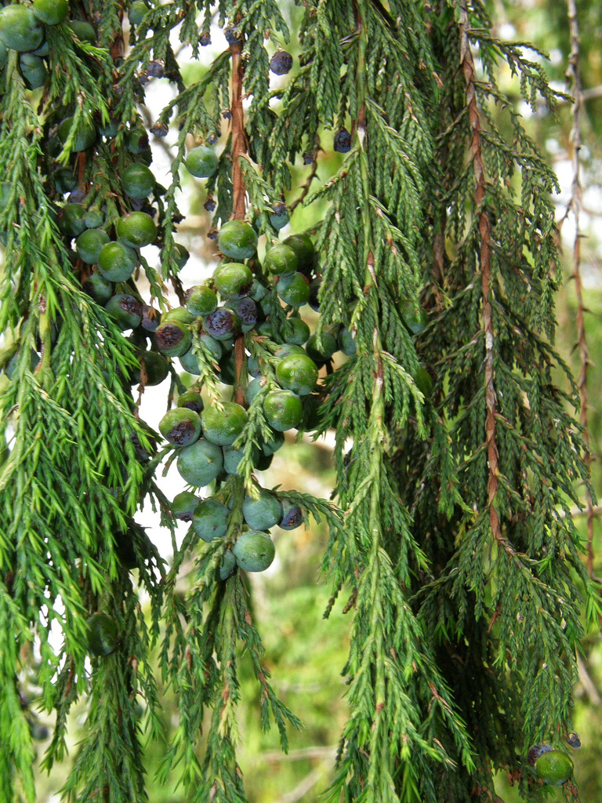
Endangered tree species

Slide 5
Hugumburda dry Afromontane forest
Low woody species richness
Olea and Juniperus widely distributed
Motivation:
Both tree species endangered
A low recruitment problem
Being over-exploited

Slide 6
Objectives
Relationship between both Olea and Juniperus
Relationship with biotic and abiotic variables
Relationship with disturbance factors

Slide 7
Study Area

Slide 8
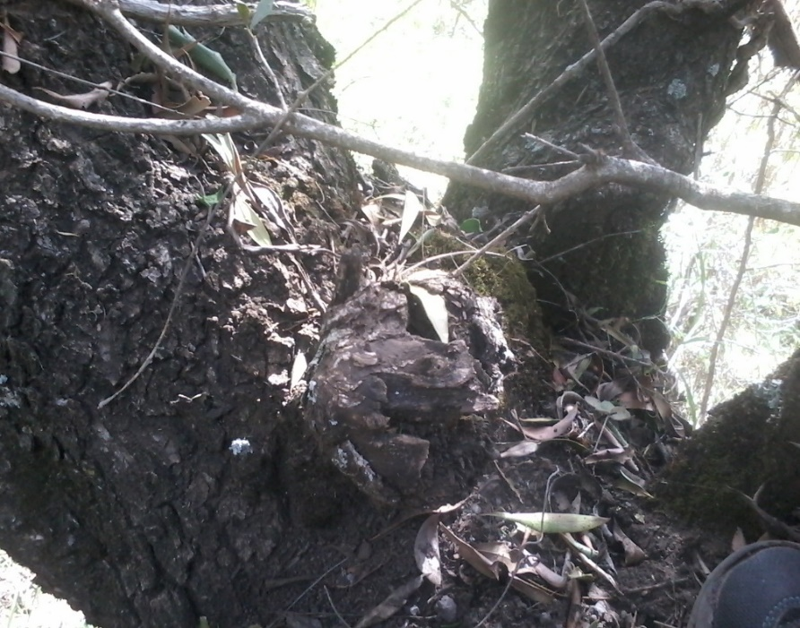
Methods
1. Biotic factors
2. Disturbance factors

Slide 9
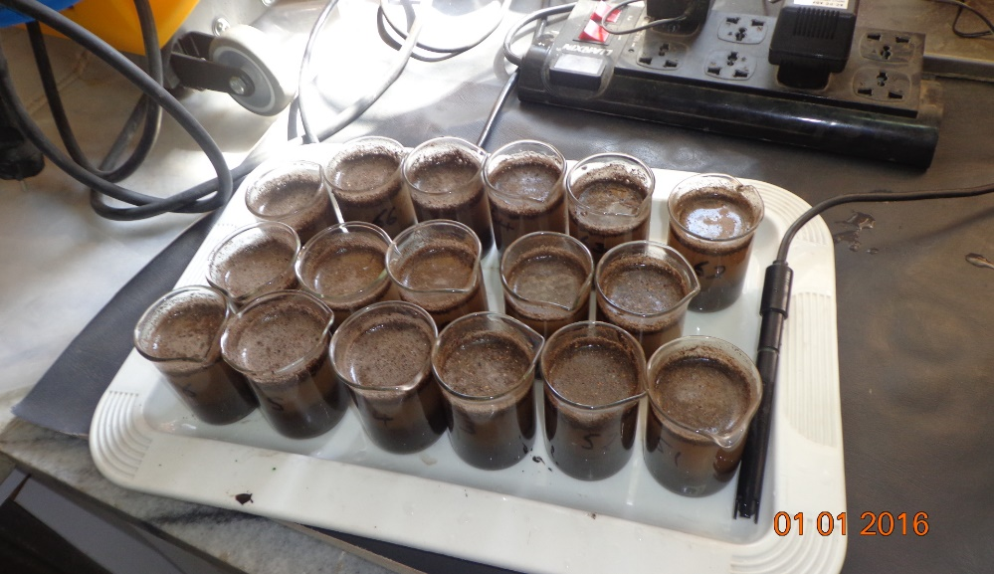
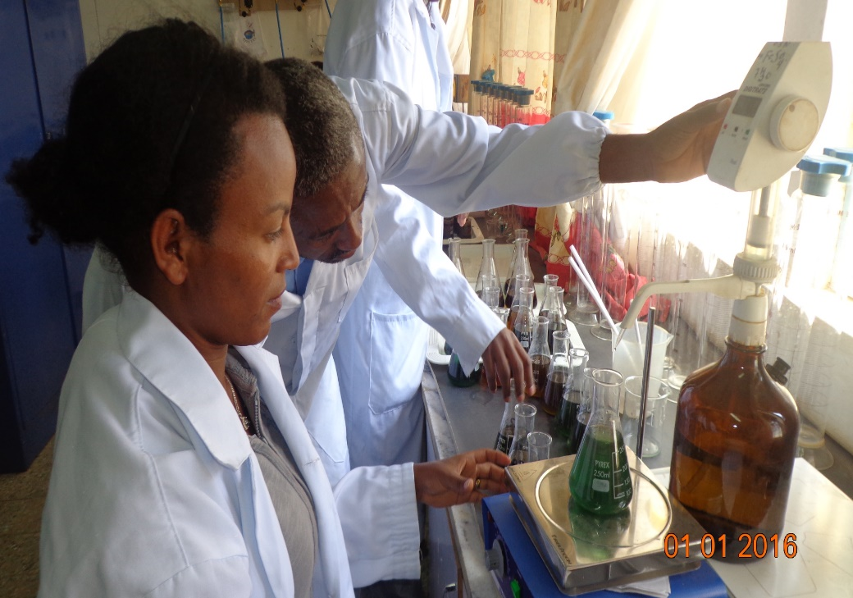
3. Abiotic factors
Soil parameters (0-15 cm)
- soil pH
- soil organic matter
- soil mositure
Environmetal gradients

Slide 10
Findings

Slide 12
Distance from the village

Slide 14
Implication and Conclusion
A positive relationship among each other
A positive relationship with elevation and woody species richness
Olea abundance positively related with number of Olea stumps
All biotic, abiotic and disturbance factors are important to species composition in study area

Slide 15
Take home message
Conserving the forest has a positive contribution for the abundance of endangered trees species

Slide 16
Thank you

