Slide 1
Habitat selection and grazing behaviour of free-ranging cattle in boreal forests of south eastern Norway
Morten Tofastrud
Inland Norway University
of Applied Sciences

Slide 2
Background
3 % of Norwegian land area is cultivated land
45 % of the land area is usable for grazing livestock
Farms have “grazing rights” in outlying areas
Grazing traditionally located to summer farms (seter)
Meløya seter, Folldal, Hedmark
930 m above sea level
Notes:
Grazing has traditionally been concentraded around summer farms, so called seters. 100 years ago there were about 100. 000 summer farms (“seter”)
Only 900 seter are still operating today

Slide 3
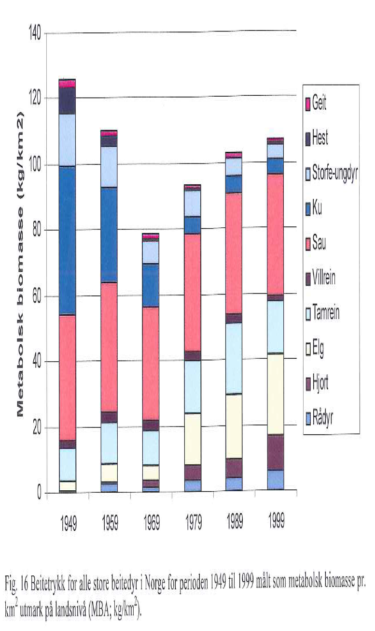
Moderate decrease in kg metabolic biomass (body weight X 0.75) of large herbivores per km² (Austrheim, Solberg, Mysterud, Daverdin, & Andersen, 2008)
Notes:
Bargraphs shows the changes in metabolic biomass of large herbivores per km2 in 50 years.
Focus on: Blue – cattle, yellow – moose, purple – red deer
After 2000 it can be observed a steady increase in the number of grazing cattle in outlying areas.

Slide 4
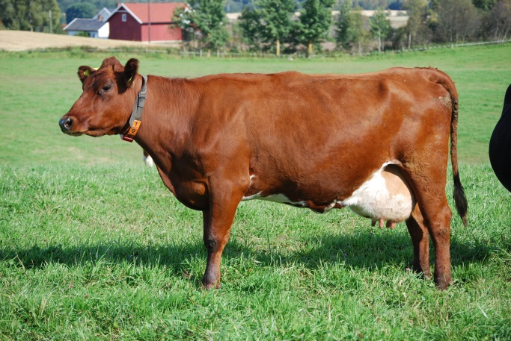
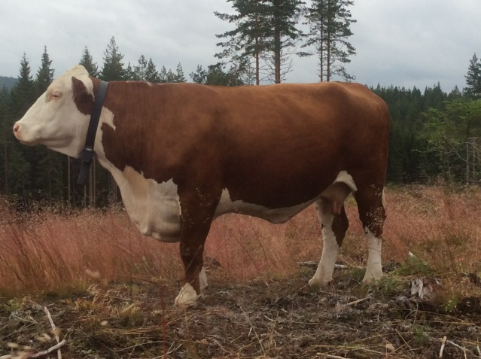
Number of animals
The Norwegian cattle population
Notes:
Over the last decades; a greater efficiency in the Norwegian dairy production has led to a decrease in the number of dairy cattle.
Fewer calve births and increased meat consumption has led to an annual loss of about 200 000 kg of beef in the Norwegian market. Which has resulted in a government focus on increasing the Norwegian beef production and thereby a steady increase in the number of grazing cattle in the forests of south-eastern Norway.

Slide 5
Cattle in multiple used forests
Vegetation
Forestry
Clearcuts, roads
Sapling damages, sapling growth, rot injuries in roots
Biodiversity
Carrying capacity
Grazing cattle
Habitat alteration, disturbance
Competition
Facilitation
Degradation of «the wild»,
fear, annoyance, road conflicts
Diseases
Depredation
Tourism
Wildlife
Notes:
Utilization of outlying grazing resources involves interactions with other interests

Slide 6
This study focus on:
Habitat selection
Grazing behaviour
Production of beef cattle
Side projects:
Diet selection of beef cattle
Pellet counts of wildlife and livestock
Seedling and clear-cut monitoring

Slide 7
Methods
31 GPS-collars with activity sensors
Vegetation mapping (NIBIO)
Diet selection:
Observations, micro histological analysis of faeces
Weighing cattle before/after grazing period

Slide 8
Study areas
Area with high stocking rate
135% of capacity (NIBIO)
Area with low stocking rate
38% of capacity (NIBIO)

Slide 9
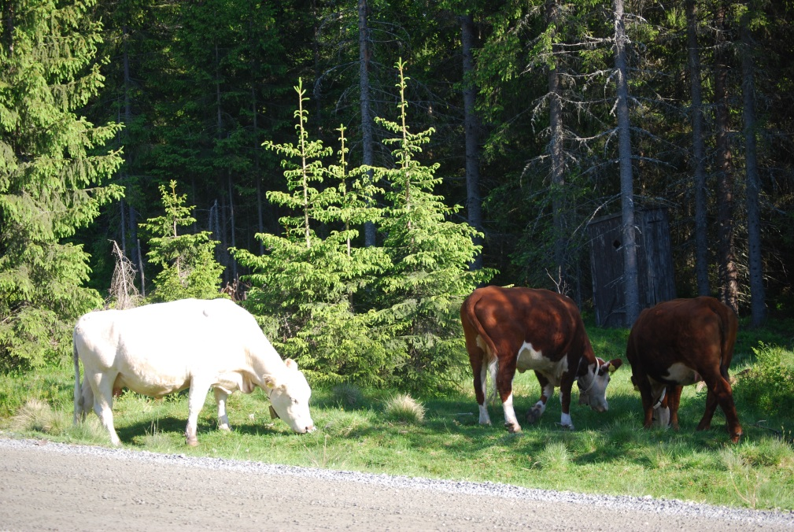
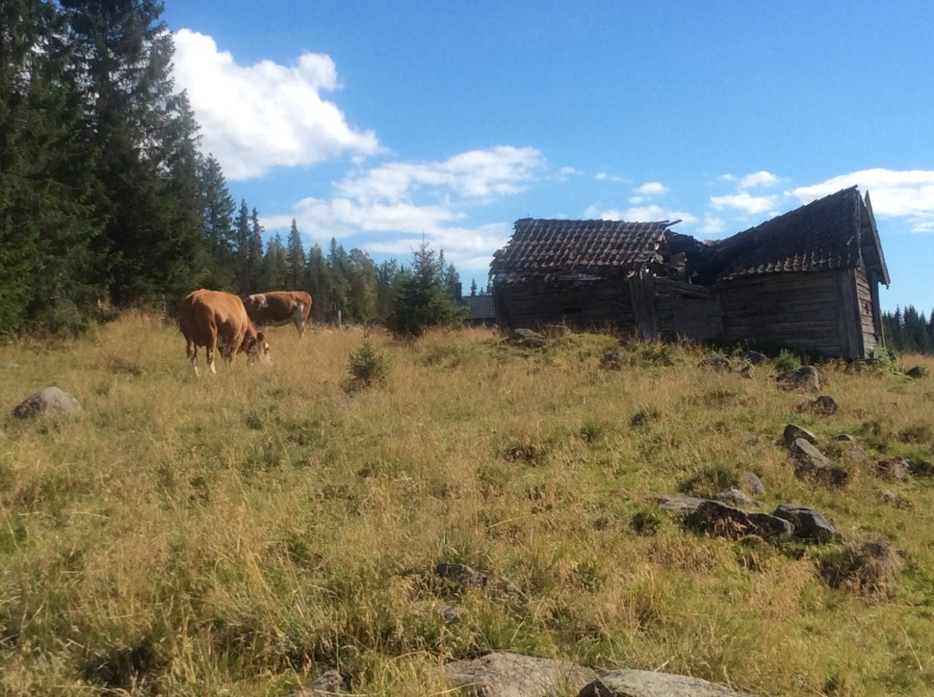
Clear-cuts
Forest roads
Main habitats
Summer farm meadows
Forest
Notes:
Forestry classes 1-5

Slide 10
Preliminary results (1)
Comparison of habitat use with habitat availability in
the area with low stocking rate 2016
Habitat type | Available, % | Used, % | Selection
Lichen and heather pine forest | 11.1 | 2.4 | - -
Bilberry pine forest | 17.3 | 12.9 | -
Bilberry spruce forest | 60.1 | 64.5 | (+)
Meadow spruce forest | 1.4 | 4.0 | +
Cultivated land | 0.4 | 4.2 | + +
Summer farm meadows | 0.2 | 7.5 | + +
Notes:
Preffered and avoided
Most preferred are grasslands

Slide 11
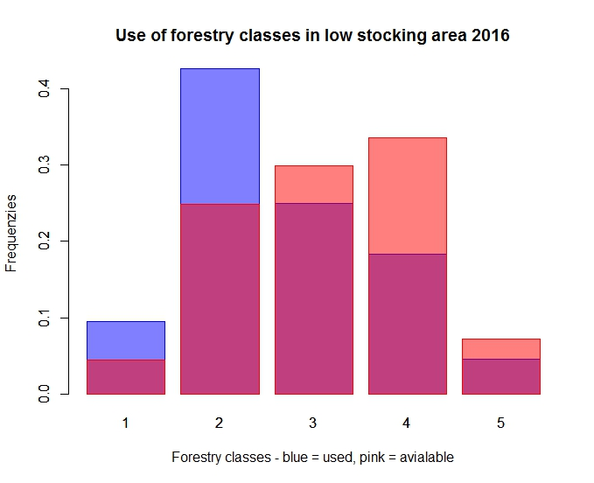
Notes:
Hogstklasse I: Snau skogsmark som skal forynges enten gjennom planting, såing eller naturlig forynging
Hogstklasse II: Ungskog. Nyetablert skog med tilfredsstillende tetthet (minst 150 planter per daa), høyden er opp til 10 – 12 m. Det kan være aktuelt å utføre ungskogpleie.
Hogstklasse III: Yngre produksjonsskog. Skogen er blitt så stor at den gir nyttbare dimensjoner. Tilveksten er høy og økende. Tynning er aktuelt.
Hogstklasse IV: Eldre produksjonsskog. Tilveksten er høy og det er aktuelt med tynning.
Hogstklasse V: Gammel hogstmoden skog. Lav tilvekst

Slide 12
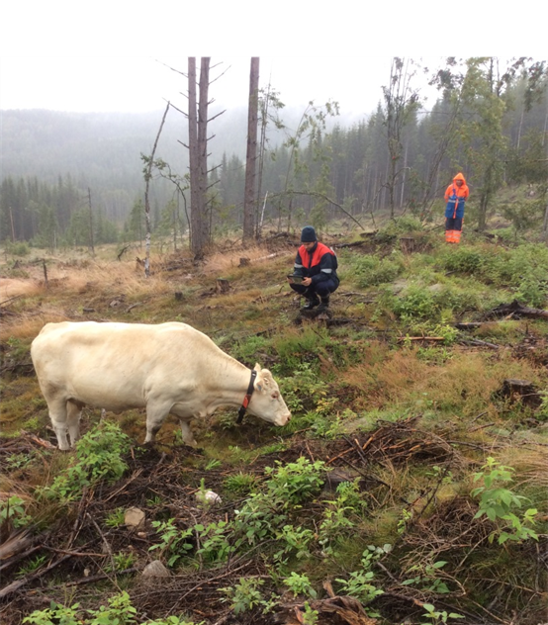
Preliminary results (3)
Classification of cattle behaviour
with validated
data from activity sensors
60%
36 %
62%
35%
Notes:
Cattle activity was greatly affected by daylight and the activity reached the highest levels around sunrise and sunset
The cattle compensated for the decreasing hours of daylight by increasing their activity levels during daytime and by expanding the hours of rest at night time.

Slide 13
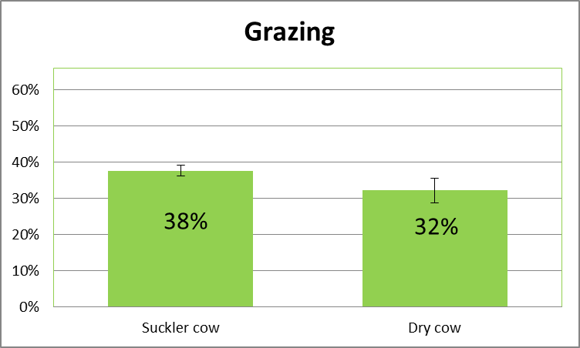
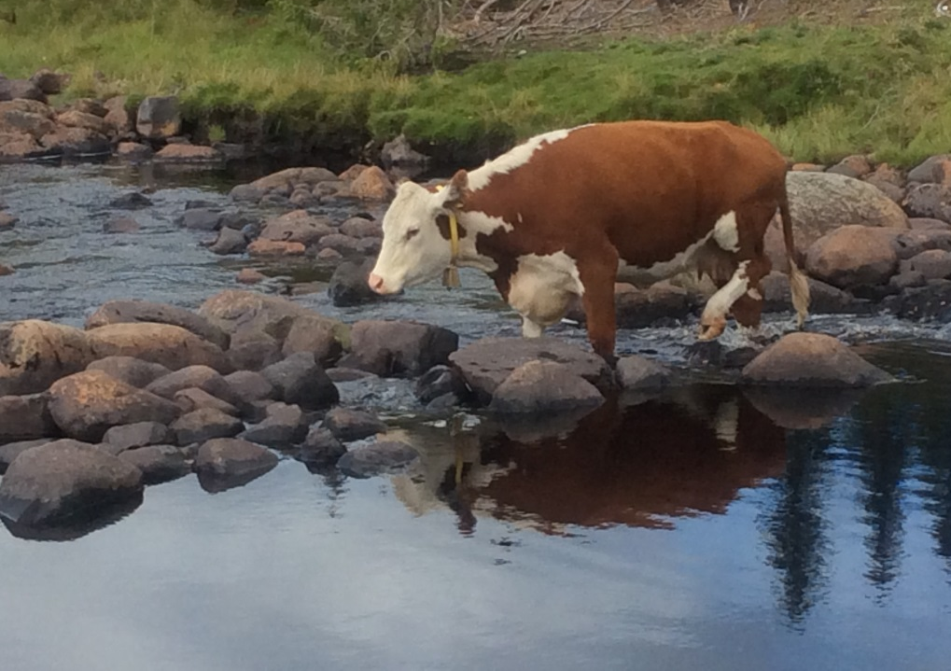
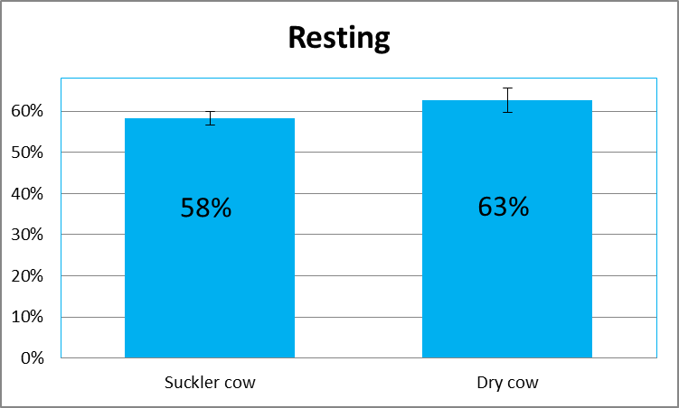
Preliminary results (4)
Activity budget for cattle
Traveling activities
Notes:
Suckler cows spent more time on grazing than dry cows, who spent more time on resting. Traveling activities was equal

Slide 14
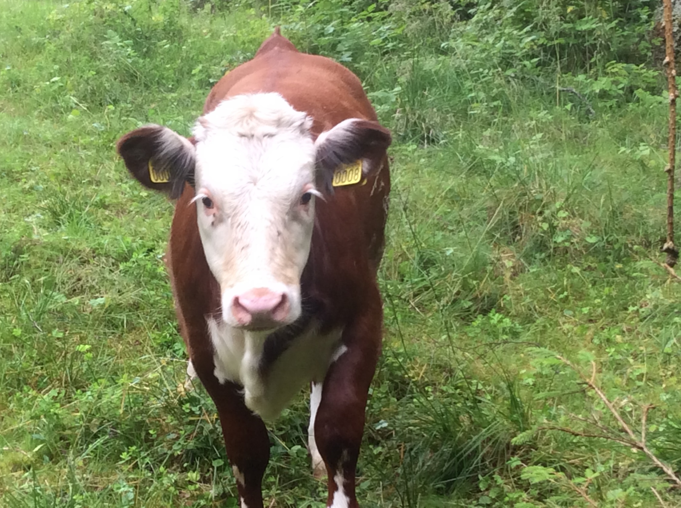
Preliminary results (5)
Weight gain
Spring born suckler calves
(low stocking rate area)
0.94 ± 0.22 kg/day
Adult cows:
Weight influenced by lactation, annual climate variations and stocking rate

Slide 15
Questions and comments?
Thanks to:
Hedmark University of Applied Sciences
Hedmark County Governor
Cattle farmers and organisations
Stange og Romedal Almenning
Furnes Almenning
NIBIO
Enthusiastic students
Overbearing cattle

