Slide 1
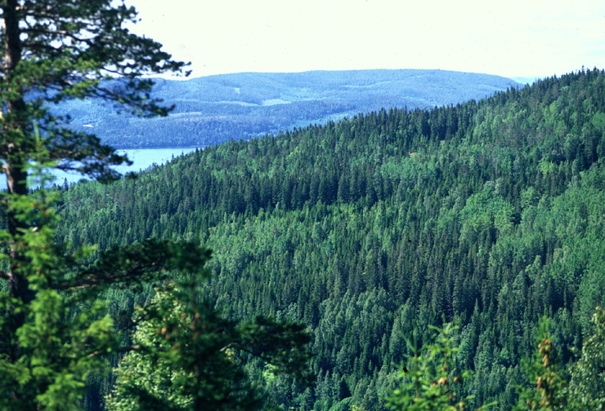
Ecosystem services – from patterns today to dynamics into the future
Tord Snäll Swedish Species Information Centre ArtDatabanken
Photo: Ola Borin

Slide 2
Outline
Ecosystem services - what is it?
Relationships between tree species richness and forest ecosystem services
Mapping ecosystem services patterns
Dynamics of ecosystem services into the future
Notes:
Next: case studies making ES concept operational, i.e. ecological studies guiding us in how management affects ES today and into the future
The first one concerns patterns in the forests of today
2nd: Concerns … and more specifically about our possibility to say something about tradeoffs and synergies based on these such mapped ES
3rd. …based on the fact that they move around in the landscape

Slide 3
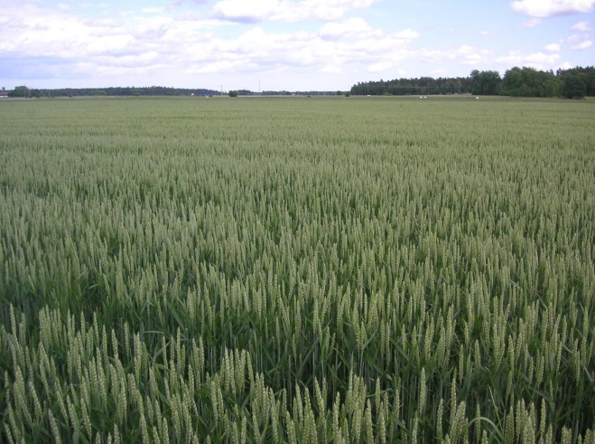
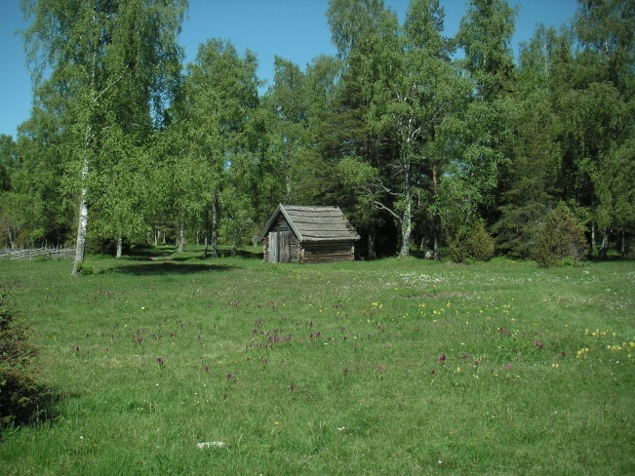
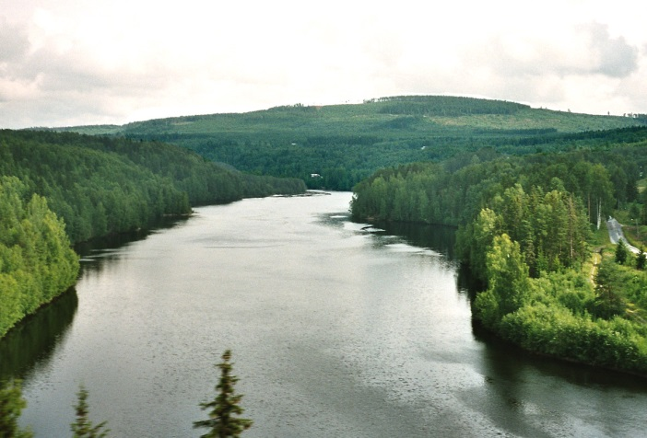
Ecosystem services - what is it?
”The conditions and processes through which natural ecosystems and the species that make them up, sustain and fulfil human life” (Daily 1997, Natures services)
”The benefits human populations derive directly or indirectly from ecosystem functions” (Costanza et al. 1997)
Notes:
Term brought up already in the 1990’ies
Avsluta: So…

Slide 4
Ecosystem services (ES)
Natural processes in ecosystems that benefit humans (one way or another)
Carried out by organisms - biological processes
Aims to show how human welfare and society depends on nature (ecosystems)
Can sometimes be valued economically
Notes:
4
Not wind

Slide 5
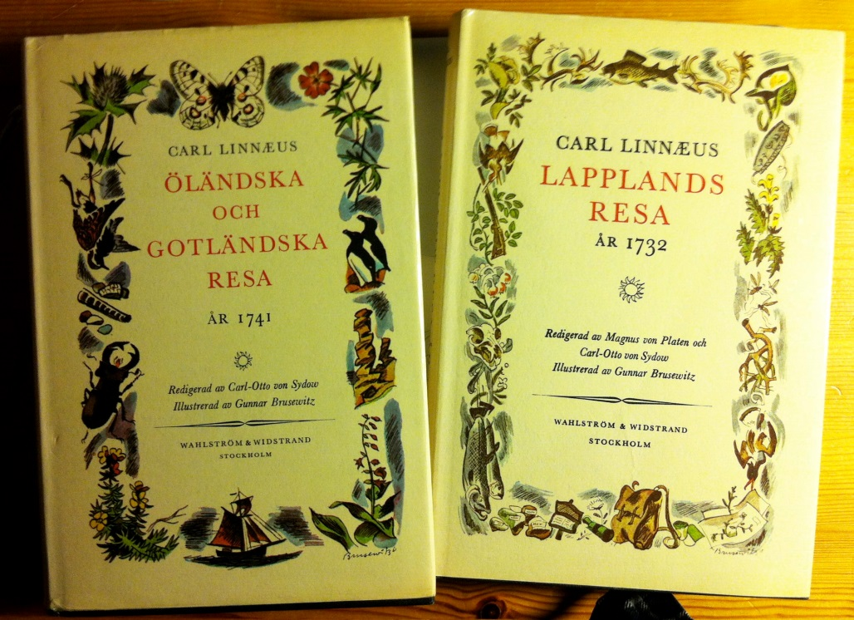
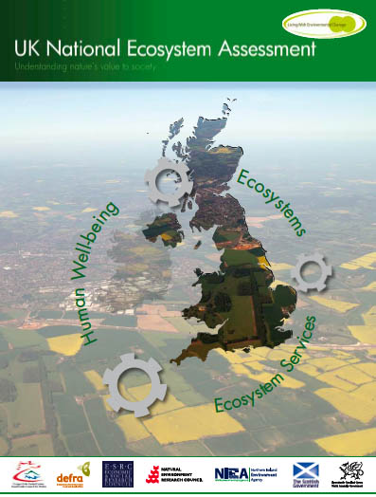
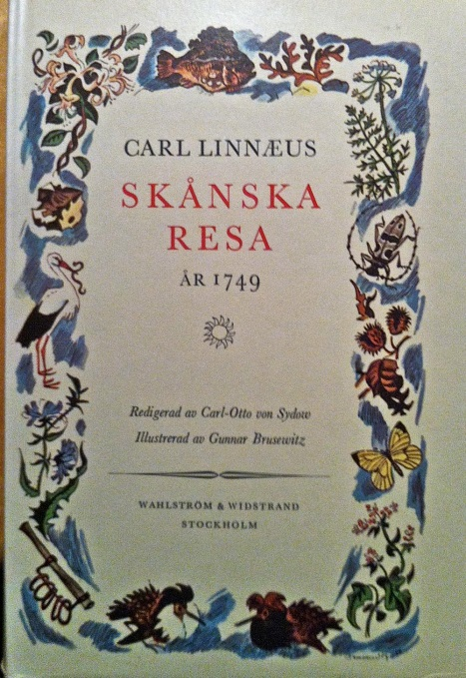
A short history of ecosystem services
Example: Linnaeus - Inventory of Sweden’s ecosystem services (1730-50)
Notes:
Inventorying the natural resources of a country is not new – this is what Linne did already in the 1700-hundreds,
while to the right is the most comprehensive one conducted in modern time
To the left are 3 ex of Linnes 5-6 published trips through Sweden.

Slide 6
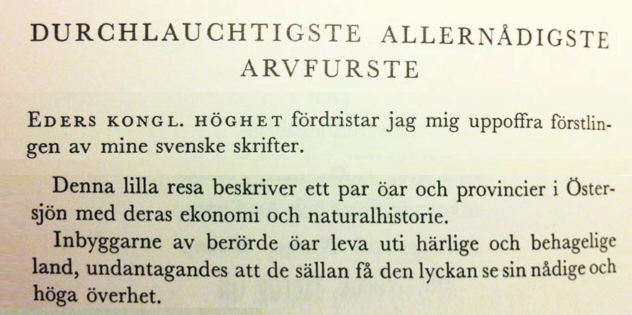
A short history of ecosystem services
Example: Linnaeus - Inventory of Sweden’s ecosystem services
Islands of Öland and Gotland, their economy and natural history
Notes:
He writes This trip…

Slide 7
A short history of ecosystem services
Example: Linnaeus - inventory of Sweden’s ecosystem services
It’s about ”farmland management, meadows, forests, tar and coal production, stones (sandstone, chalk)” etc.
= NATURAL RESOURCES
Notes:
Moreover, It’s about…
So, mapping ES is not new but an important activity.
This explains the large resources having been allocated to this in recent times.
There is now national and EU level work to map ES and include them in the national accounting.
The UK early made a large-scale assessment

Slide 8
The UK NEA (National Ecosystem Assessment; 2011)
Society relies on ecosystem services
”The benefits that we derive from … ecosystems are critically important to human well-being and economic prosperity, but are consistently undervalued in economic analyses and decision making”
Notes:
The make it clear that Society… [läs också bruna]
Studying ESS has always involved also studying trade-offs and conflicts

Slide 9
The UK NEA (National Ecosystem Assessment; 2011)
Society relies on ecosystem services
”The benefits that we derive from … ecosystems are critically important to human well-being and economic prosperity, but are consistently undervalued in economic analyses and decision making”
Trade-offs between provisioning (production) and other ecosystem services
”The emphasis on provisioning services to meet the increased need for food, fibre, water and energy, has resulted in degradation of many UK ecosystems and the delivery of many regulating, supporting and cultural services”
Notes:
Läs allt: Tradeoffs…
This early, extensive national report reflects the strong link between ESS and policy

Slide 10
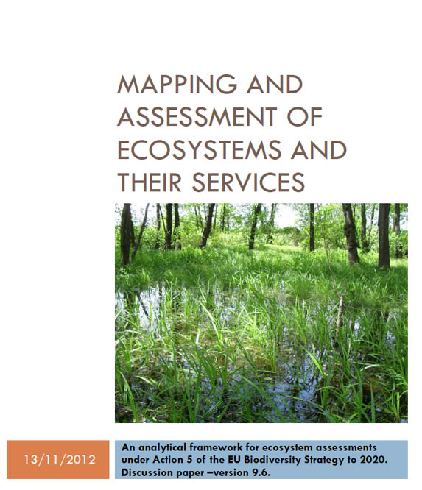
Ecosystem services and policy
EU (and national governments) aims to include ecosystem services in policy and natural capital accounts by 2020.
1.3.2 The link between ecosystems, ecosystems services and biodiversity … The assessment of the multiple ecosystem services in combination with the analysis of synergies and trade-offs between these services is the basis for valuing the multi-functionality of ecosystems for human well-being.
Notes:
Efter punkt 1:
The ES concept is thus included in national accounting texts and for Sweden I even think that all ESS should be valued by 2020.
These texts also mention the link to biodiversity, synergies and tradeoffs [LÄS]
Efter punkt 2:
ESS is a wide concept and working on them is simplified by some sort of structuring

Slide 11
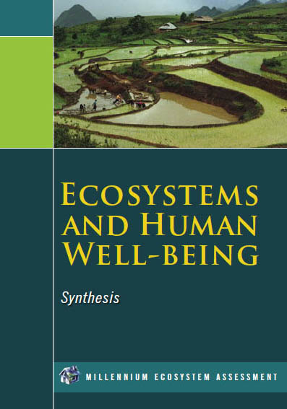
Classification of ecosystem services? Unclear and under evolution
Millennium Ecosystem Assessment (MA)
Provisioning
Regulating
Supporting
Cultural services
Notes:
11
Most commonly seen in science
Prov: wood or bilberry production; Regulating: carbon sequestration;
Supporting serv underpinning all other services: primary production of organic material that we use;
Cultural: picking berries, viewing biodiversity and beautiful forest landscapes
But the EU has a somewhat wider perspective

Slide 12
EU - CICES Common International Classification of Ecosystem Services
Ecosystem services
Indirect ecosystem services, processes and functions
Direct ecosystem services
Goods (commodi-ties)
Value
Soil formation
Primary production
Nutrient cycling
Biomass production
Pollination
Biological control
…
Yield:
- Food production - Tree production
Clean water
Water regulation
…
Drinking (or useful) water
Cereals, meat, vegetables
Timber, fibre, pulp
Flood protection
…
Monetary €
Quantitative +/-
Qualitative ☺/☹
Notes:
12
This is the EU-CICES classification
It is simpler in defining two main groups of ES, but also talks about Goods and their Values
But what can we use the term ”ES” for – what is it?

Slide 13
What is ”ecosystem services”?
A pedagogical tool highlight dependency on nature to public and policy-makers
- the original meaning focussing ecological research
A method for making Nature a commodity that can be traded on the market
- the concept co-opted by economists and neoliberalism for managing nature based on ”policy as economics”
Notes:
LÄS
How do we then make ES operational, i.e use them in practice?

Slide 14
How do we make ”ecosystem services” operational?
Devising methods to measure them
Understanding the ecological (and other) mechanisms
Developing tools to assess and manage them
Economic valuation? Only in special cases: - when the actors in society agree on values and valuation - when there are few conflicts between present and future - when it’s clearly needed for making good decisions
Notes:
Present, future: i.e. when the value does not change
Next: case studies making ES concept operational, i.e. ecological studies guiding us in how management affects ES today and into the future
The first one concerns patterns in the forests of today

Slide 15
Outline
Ecosystem services - what is it?
Relationships between tree species richness and forest ecosystem services
Mapping ecosystem services patterns
Dynamics of ecosystem services into the future
Notes:
The main motive for this study is the described reliance of ES on biodiversity – at this time the relationship between E FUNCTION and biodiv in forest was well established but none had studies the link btween different ES and biodiversity.

Slide 16
Higher levels of multiple ecosystem services are found in forests with more tree species
Lars Gamfeldt, Tord Snäll, Robert Bagchi, Micael Jonsson, Lena Gustafsson, Petter Kjellander, María C. Ruiz-Jaen, Mats Fröberg, Johan Stendahl, Christopher D. Philipson, Grzegorz Mikusinksi, Erik Andersson, Bertil Westerlund, Henrik Andrén, Fredrik Moberg, Jon Moen & Jan Bengtsson. 2013. Nature. Comm. 4:1340. Länk: http://www.nature.com/ncomms/journal/v4/n1/abs/ncomms2328.html
Notes:
Leader was LG, postdoc at that time, but we were many authours reflecting a wide range of competences

Slide 17
Project questions
What are the relationships between ecosystem services and tree species richness?
What are the relationships between ecosystem services and the biomass of different tree species?
What are the correlations between ecosystem services – is there any evidence for trade-offs?

Slide 18
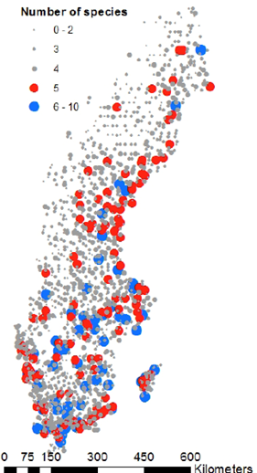
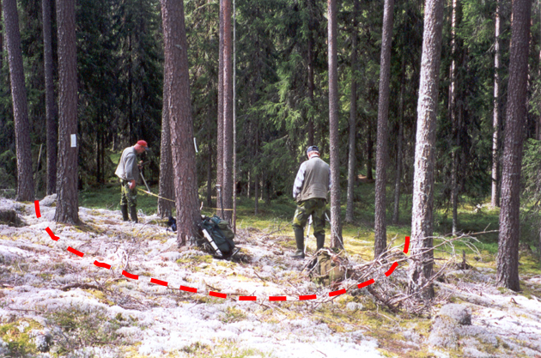
The empirical data
The Swedish National Forest Inventory
Productive forests (>1 m³ ha⁻¹ yr⁻¹)
…

Slide 19
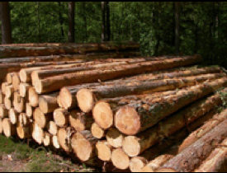
Six ecosystem services
Tree biomass production (kg m⁻² yr⁻¹)

Slide 20
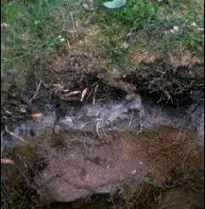
Six ecosystem services
Tree biomass production (kg m⁻² yr⁻¹)
Soil carbon storage (g m⁻² in topsoil)

Slide 21
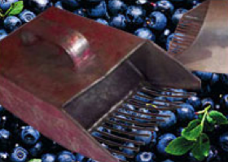
Six ecosystem services
Tree biomass production (kg m⁻² yr⁻¹)
Soil carbon storage (g m⁻² in topsoil)
Bilberry (Vaccinium myrtillus) cover

Slide 22
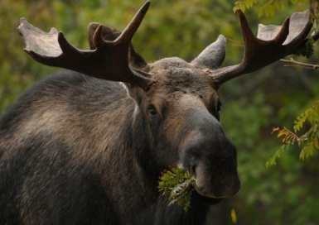
Six ecosystem services
Tree biomass production (kg m⁻² yr⁻¹)
Soil carbon storage (g m⁻² in topsoil)
Bilberry (Vaccinium myrtillus) cover
Wild game production potential (cover of preferred food)

Slide 23
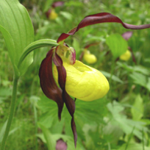
Six ecosystem services
Tree biomass production (kg m⁻² yr⁻¹)
Soil carbon storage (g m⁻² in topsoil)
Bilberry (Vaccinium myrtillus) cover
Wild game production potential (cover of preferred food)
Species richness of understory vegetation

Slide 24
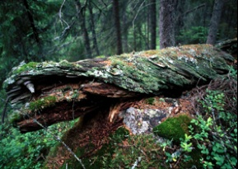
Six ecosystem services
Tree biomass production (kg m⁻² yr⁻¹)
Soil carbon storage (g m⁻² in topsoil)
Bilberry (Vaccinium myrtillus) cover
Wild game production potential (cover of preferred food)
Species richness of understory vegetation
Dead wood occurrence

Slide 25
Analysis approach
Statistical modelling of ecosystems services as a function of environmental variables and tree species richness
environmental variables:
Temperature
Nitrogen deposition
Humidity
Soil variables (moisture, pH, C:N ratio, soil type)
Biomasses of dominating tree species
Interactions between the variables, the variables squared
Stem density
Site productivity (a productivity index)
Basal area
Tree species richness
Notes:
Temperatursumma. Den sammanlagda dygnsmedeltempera-
turen över +5° under vegetationsperioden.
Humiditet. Skillnaden mellan tillskott av vatten via nederbörd
och avdunstning plus transpiration under
vegetationsperioden
Båda kommer från SMHI

Slide 26
Analysis approach
Statistical modelling of ecosystems services as a function of environmental variables and tree species richness
ES = α + βX
Ecosystem service (ES)
Positive relationship -> β is positive
Negative relationship -> β is negative
X
Notes:
e

Slide 27
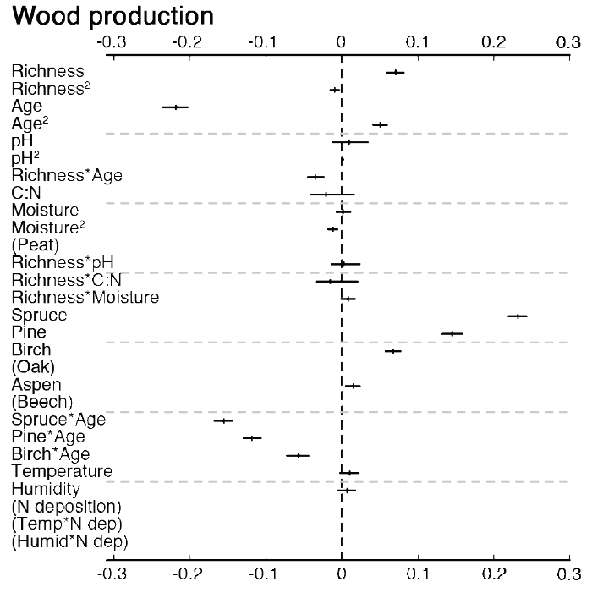
Tree biomass production
β
Short vertical: most probable regression slope value
Horizontal: 95% conf. interval
β

Slide 28
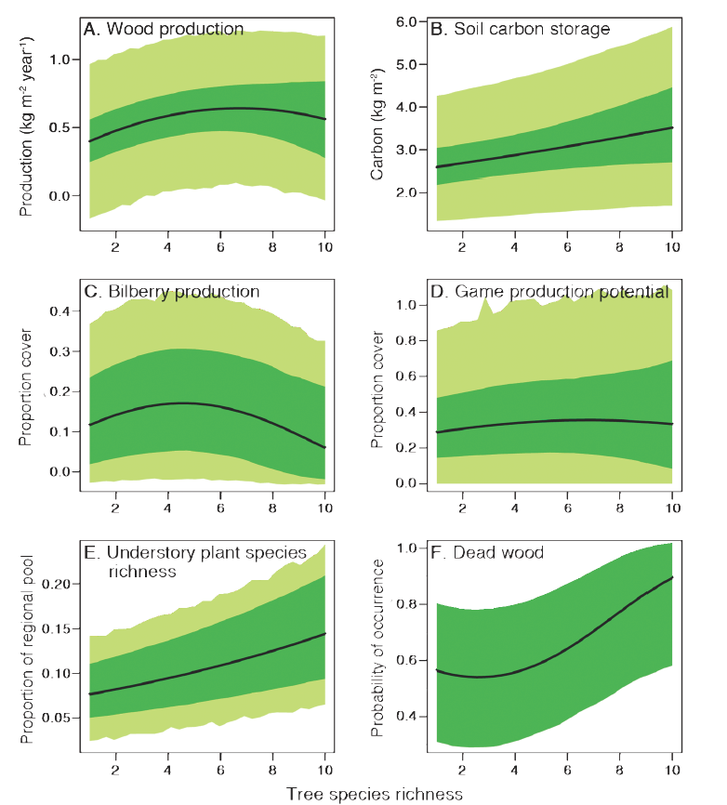
Relationships ecosystem services and tree species richness
Wood production
Soil C storage
95% prediction interval including residual variation
95% prediction interval based on regression parameter estimates
Bilberry
Game potential
Understory plants
Dead wood
Tree species richness
Notes:
Skriv tolkningar som ska perättas om

Slide 29
Project questions
What are the relationships between ecosystem services and tree species richness?
What are the relationships between ecosystem services and the biomass of different tree species?
What are the correlations between ecosystem services – is there any evidence for trade-offs?

Slide 30
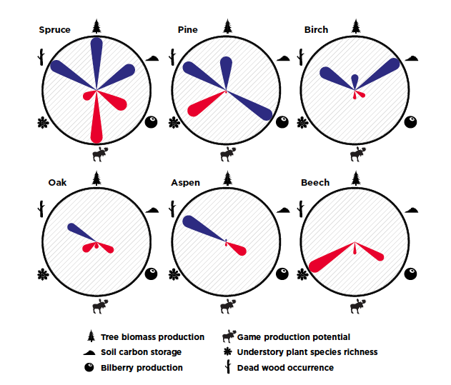
Tree species identity
positive
negative
Notes:
Timmervältan från Skogsforum.se

Slide 31
Project questions
What are the relationships between ecosystem services and tree species richness?
What are the relationships between ecosystem services and the biomass of different tree species?
What are the correlations between ecosystem services – is there any evidence for trade-offs?

Slide 32
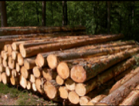
Trade-offs between services
positive
negative

Slide 33
Conclusions
There are positive relationships between ecosystem service levels and tree species richness, after accounting for environmental variables and tree biomasses
The biomass of specific species is important, but in addition there is a positive relationship to tree species richness
More species-rich forest show higher multifunctionality
Trade-offs between services exist, but higher levels of multiple services may be obtained with some mixing of tree species

Slide 34
Outline
Ecosystem services - what is it?
Relationships between tree species richness and forest ecosystem services
Mapping ecosystem services patterns
Dynamics of ecosystem services into the future
Notes:
Next: case studies making ES concept operational, i.e. ecological studies guiding us in how management affects ES today and into the future
The first one concerns patterns in the forests of today
2nd: Concerns …

Slide 35
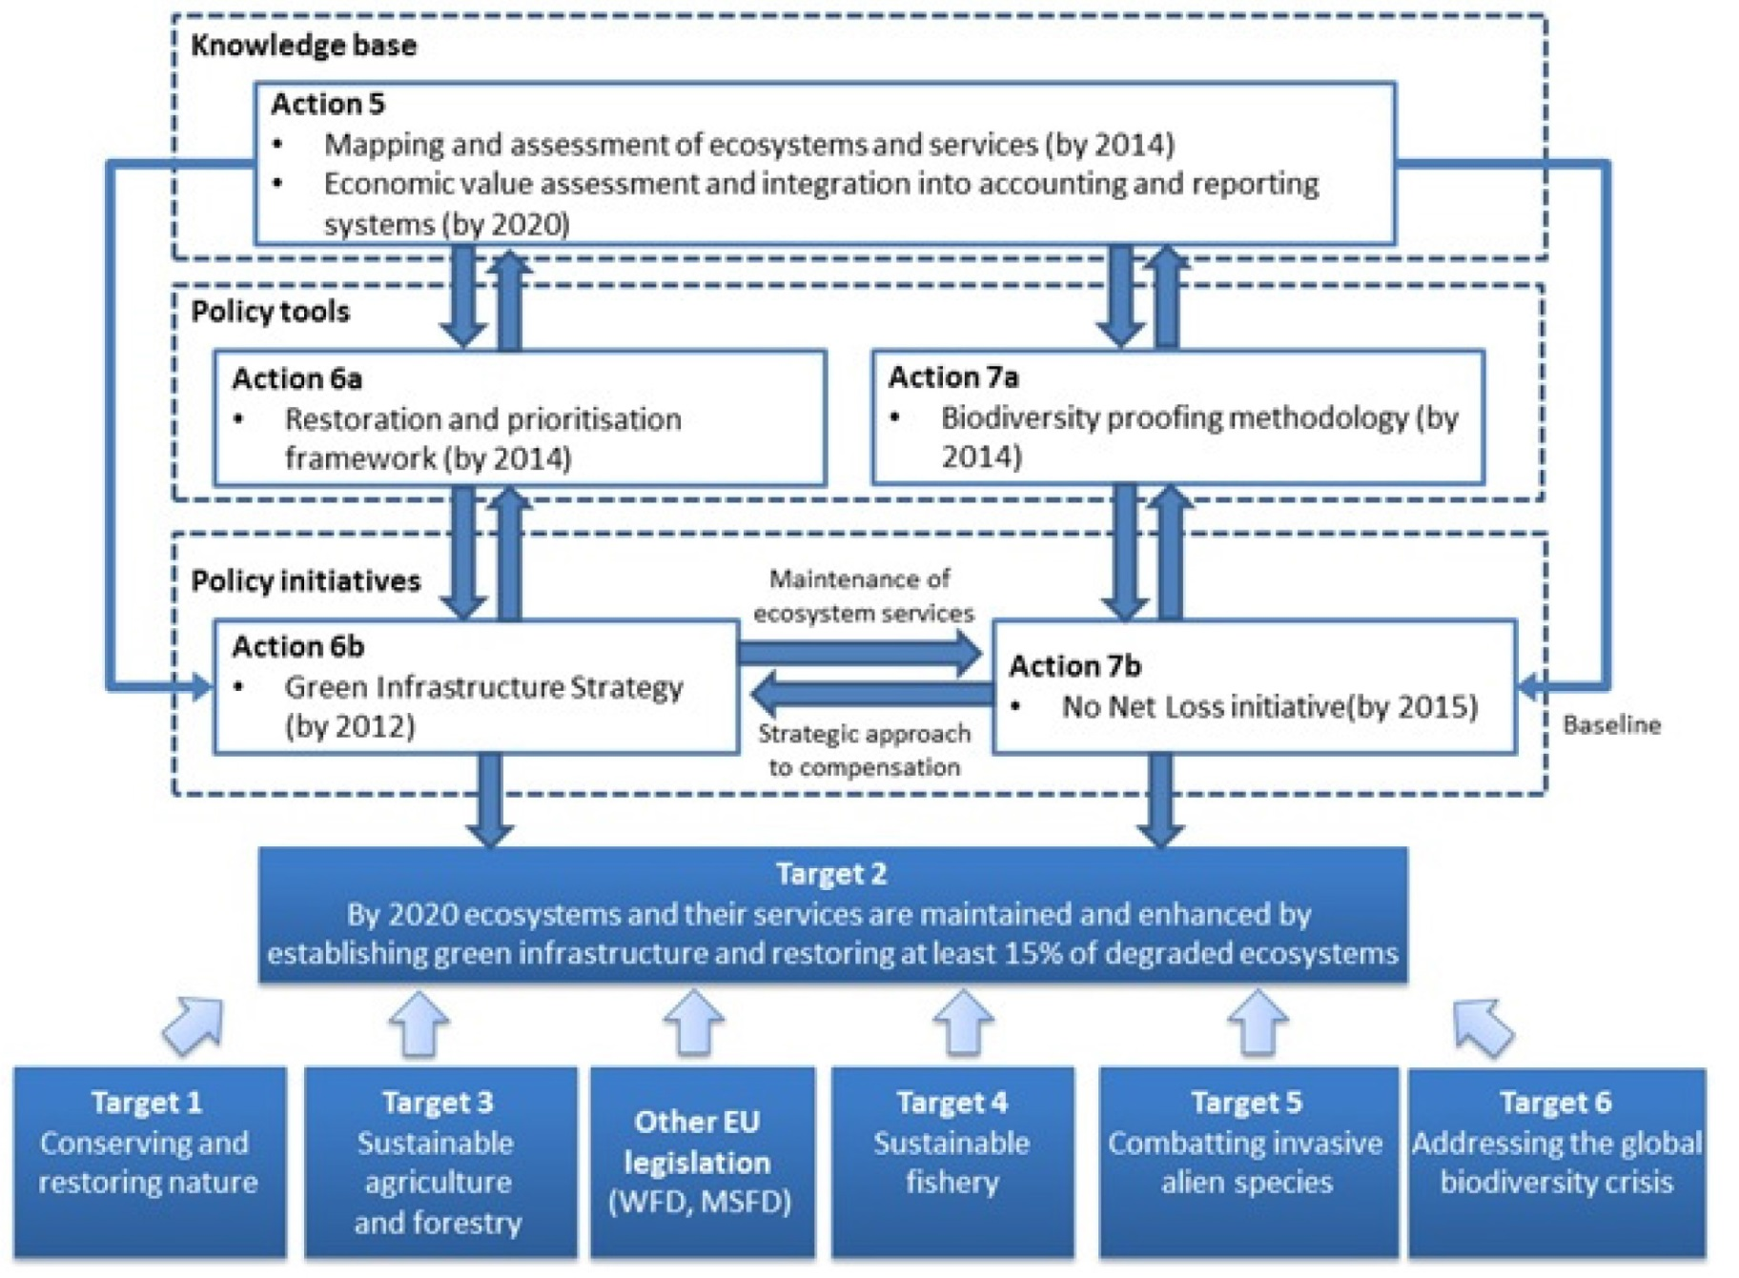
Common Implementation Framework of the EU Biodiversity Strategy 2020
Notes:
Action 5 of the EU Biodiversity Strategy to 2020 calls Member States to map and assess the state of ecosystems and their services in their national territory with the assistance of the European Commission. I will talk about our possibility to say something about tradeoffs and synergies based on these such mapped ES

Slide 36
Aim
To test an approach for mapping ecosystem services at different spatial scales.
National Forest Inventory data and remote sensing data are used.
To identify
trade-offs, synergies
among ecosystem services in production forests
To investigate how ecosystem services change through time

Slide 37
Correlations between services – trade-offs or synergies?
positive
negative
Gamfeldt et al. (2013)

Slide 38
Three ecosystem services
Tree biomass production (kg m⁻² yr⁻¹)

Slide 39
Three ecosystem services
Tree biomass production (kg m⁻² yr⁻¹)
Soil carbon storage (g m⁻² in topsoil)

Slide 40
Three ecosystem services
Tree biomass production (kg m⁻² yr⁻¹)
Soil carbon storage (g m⁻² in topsoil)
Bilberry (Vaccinium myrtillus) cover

Slide 41
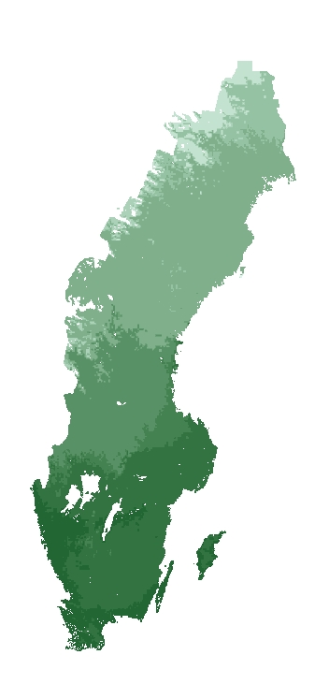
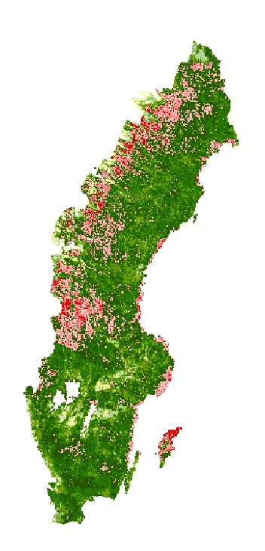
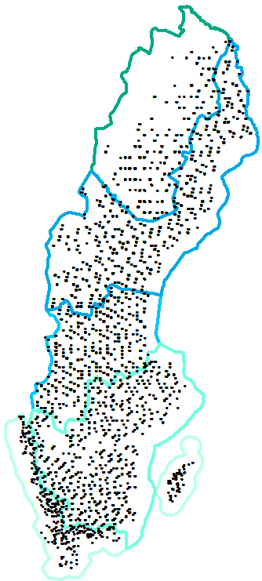
Statistical modelling of ecosystem services
Ecosystem service
(field measurement)
Length of vegetation period
Stand age (kNN Sweden)
β₀
β₁
β₂
x
x
ArtDatabanken

Slide 42
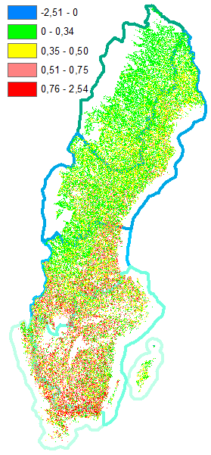
Prediction of wood production
Length of vegetation period
Stand age (kNN Sweden)
Wood production
β₀
β₁
β₂
x
x
+ other explanatory variables
ArtDatabanken

Slide 43
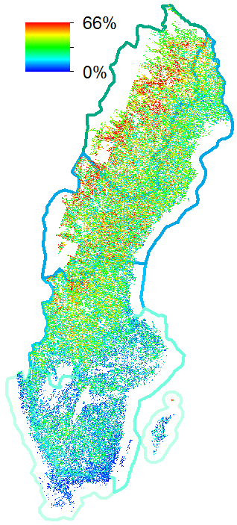
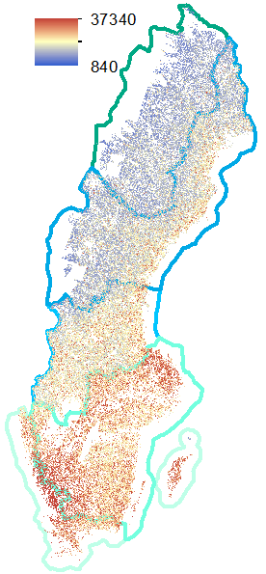
Mapped ecosystem services
Wood production
Bilberry cover
Soil carbon storage
kg/m²
kg/m²/yr
R²=0.36
R²=0.38
R²=0.18

Slide 44
Trade-offs, synergies
Wood production
Bilberry cover
National scale: highest yield either in the south (wood production) or in the north (bilberry)
kg/m²/yr
At the landscape scale:
- Conflicts? - Synergies? - Focus on one service? - Unsuitable for all services?

Slide 45
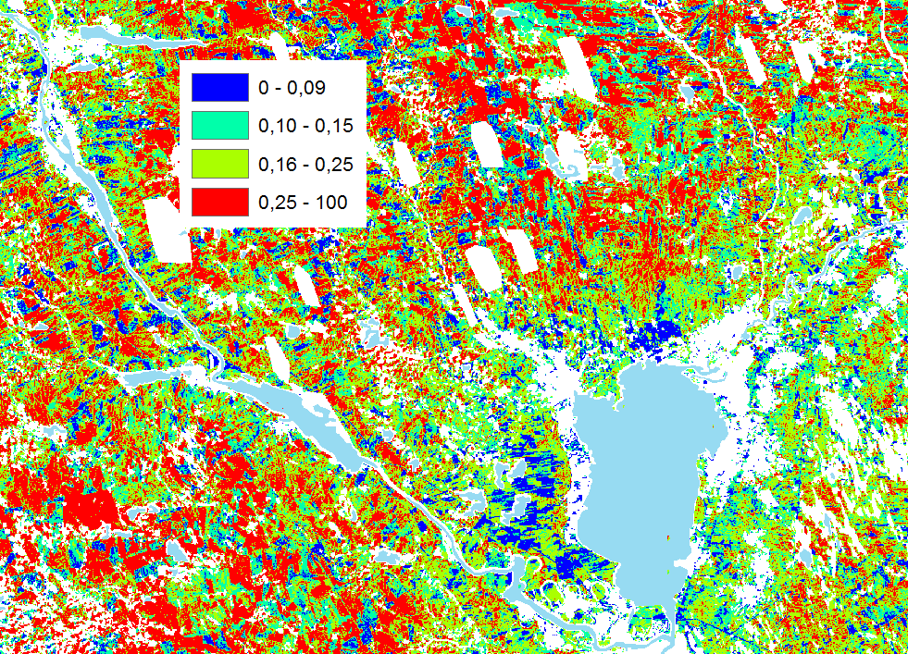
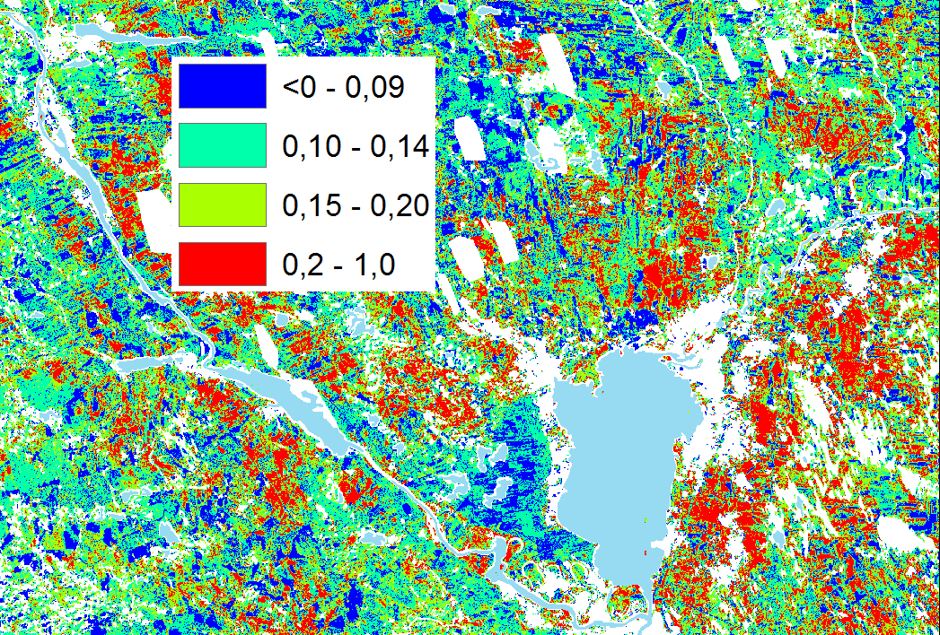
Trade-offs, synergies
Quartiles of normalized values
Bilberry cover
Wood production
0 – 25%
25% – 50%
50% – 75%
75% – 100%
0 – 25%
25% – 50%
50% – 75%
75% – 100%
0,26 - 1
lake
10 km
Hotspot: >75% of both
Coldspot: <25% of both
Suitable for either one or the other (>75% & <25%)

Slide 46
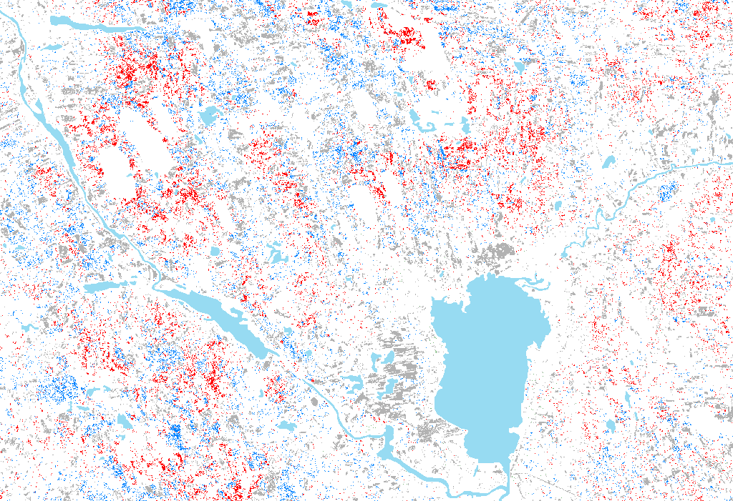
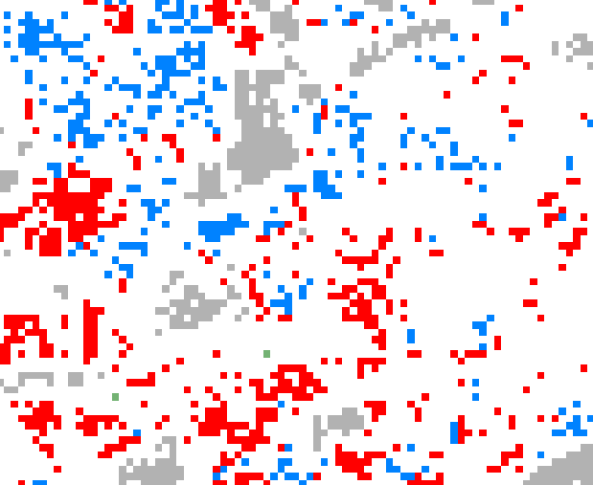
Hotspot
Wood production (not bilberry)
Bilberry (not wood production)
Coldspot (unsuitable for both)
Not particularly good for either one
10 km

Slide 47
Negative interactions
(mechanisitically or
resulting from management)
Positive interactions,
Independence,
Hotspot (synergy, trade-off)
Wood production (not bilberry)
Bilberry (not wood production)
Coldspot (unsuitable for both)
Not particularly good for either one
10 km
Notes:
Tradeoff: negative interactions resulting from managing for once service which negatively affects another.
Example: Manage for wood by making the forest dense-> low light at forest floor decreasing leading to low bilberry cover
Synergy:
By mangement: Creation of gaps in the forest by felling some trees will benefit bilberry, but also dead biodiversity if you leave the trees decomposing
Independence: in forest with gaps we will both have preferred food for wildlife that we can hunt and we can go watching a beautiful and rich vascular plant field layer.
So, in summary, there are clear limitations in our possibility to make assessments of tradeoffs and synergies based on measured or mapped ES
A final reason for this limitation is that in many systems, ES move around through time

Slide 48
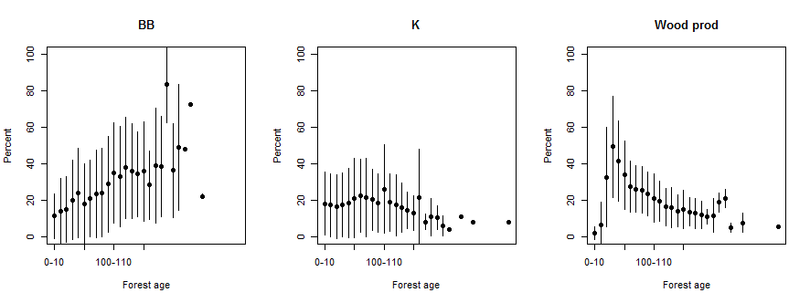
ES changing through time
Bilberry
Carbon storage
Wood production
% of maximum
Forest age
Forest age
Forest age
Notes:
That is shown by this plot. It showns how the the levels of ES change with forest age.
This means that the high levels of ES move around in the landscape
BB levels increase with forest age – contin increase and then drastic reduction aefter clearcutting
WP increases and the decreases through time
This explains why we have started taking a more dynamic approach in studying ES

Slide 49
Conclusions
We can develop reasonable models for certain ecosystem services using explanatory variables obtained by modelling or remote sensing
The qualitative properties of the models are similar to the ones developed based on field measurements. The predictive ability at the national scale is good and at the 25 x 25 m-pixels scale it is satisfactory
We can identify hotspots, coldspots, but not trade-offs and synergies based on patterns of ecosystem services
Whether hotspot locations are tradeoffs or synergies depend on the interactions between the services (mechanistic or management)
ES levels change through time -> trade-offs, synergies, hotspots, coldspots move around in the landscape

Slide 50
Outline
Ecosystem services - what is it?
Relationships between tree species richness and forest ecosystem services
Mapping ecosystem services patterns
Dynamics of ecosystem services into the future
Notes:
3rd. The fact that they move around through time and into the future explains why we have recently started studying realtinships between ESS and biodiversity using an approach based on dynamic simulations and optmizations. We have recently started this so I exemplify it based on a published study by my collaborators

Slide 51
Questions
How do we maintain sustainable forestry at the landscape scale and in the long run?
This is a multiobjective optimization question
Conflicts and synergies among biodiversity, timber production and other ecosystem services?
Optimal combination of management actions in space and time – how to reconcile the conflict?
Tools to put things into practice

Slide 52
Materials and methods
Real forest data + forest simulator + models for ecosystem services and biodiversity indicators
Study area
17 watersheds in central & south Finland
> 32 000 stands, 45 000 ha
Variation in productivity (soil productivity) and conservation capacity (age)
High
Catchment 1
Catchment 2
Catchment 3
Catchment 4
Catchment 1
Catchment 2
Low
High
Landscape conservation capacity
Catchment 3
Catchment 4
Low
Productivity

Slide 53
Materials and methods
Simulations (SIMO) 100 years
Management options
Set aside
BAU: current forest management recommendations (rotation forest management)
BAU +/- 10/20/30 years, changes in rotation lengths
BAU with and w/O thinnings
GTR: green tree retention, BAU + 3 x more trees retended
CCF: continous cover forestry
→ All stands have 19 alternative trajectories 100 years into the future

Slide 54
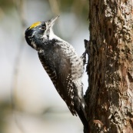
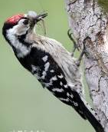
Forest stand characteristics translated into ESS and BD indicators
Net present value of timber (€)
Timber production (m³)
Carbon stock (biomass + soil)
Yield of collectable goods
bilberry
lingonberry
mushrooms
Scenic beauty
Deadwood: diversity index
Habitat suitability index
6 vertebrate species
All red-listed, deadwood dependend fungi and invertebrates
Ecosystem services
Trivino et al 2015: Ecosystem Services
Trivino et al. 2017: J. Appl. Ecol.
Peura et al. 2016: Silva Fennica
Biodiversity
Mönkkönen et al 2014: J.Environ.Manage

Slide 55
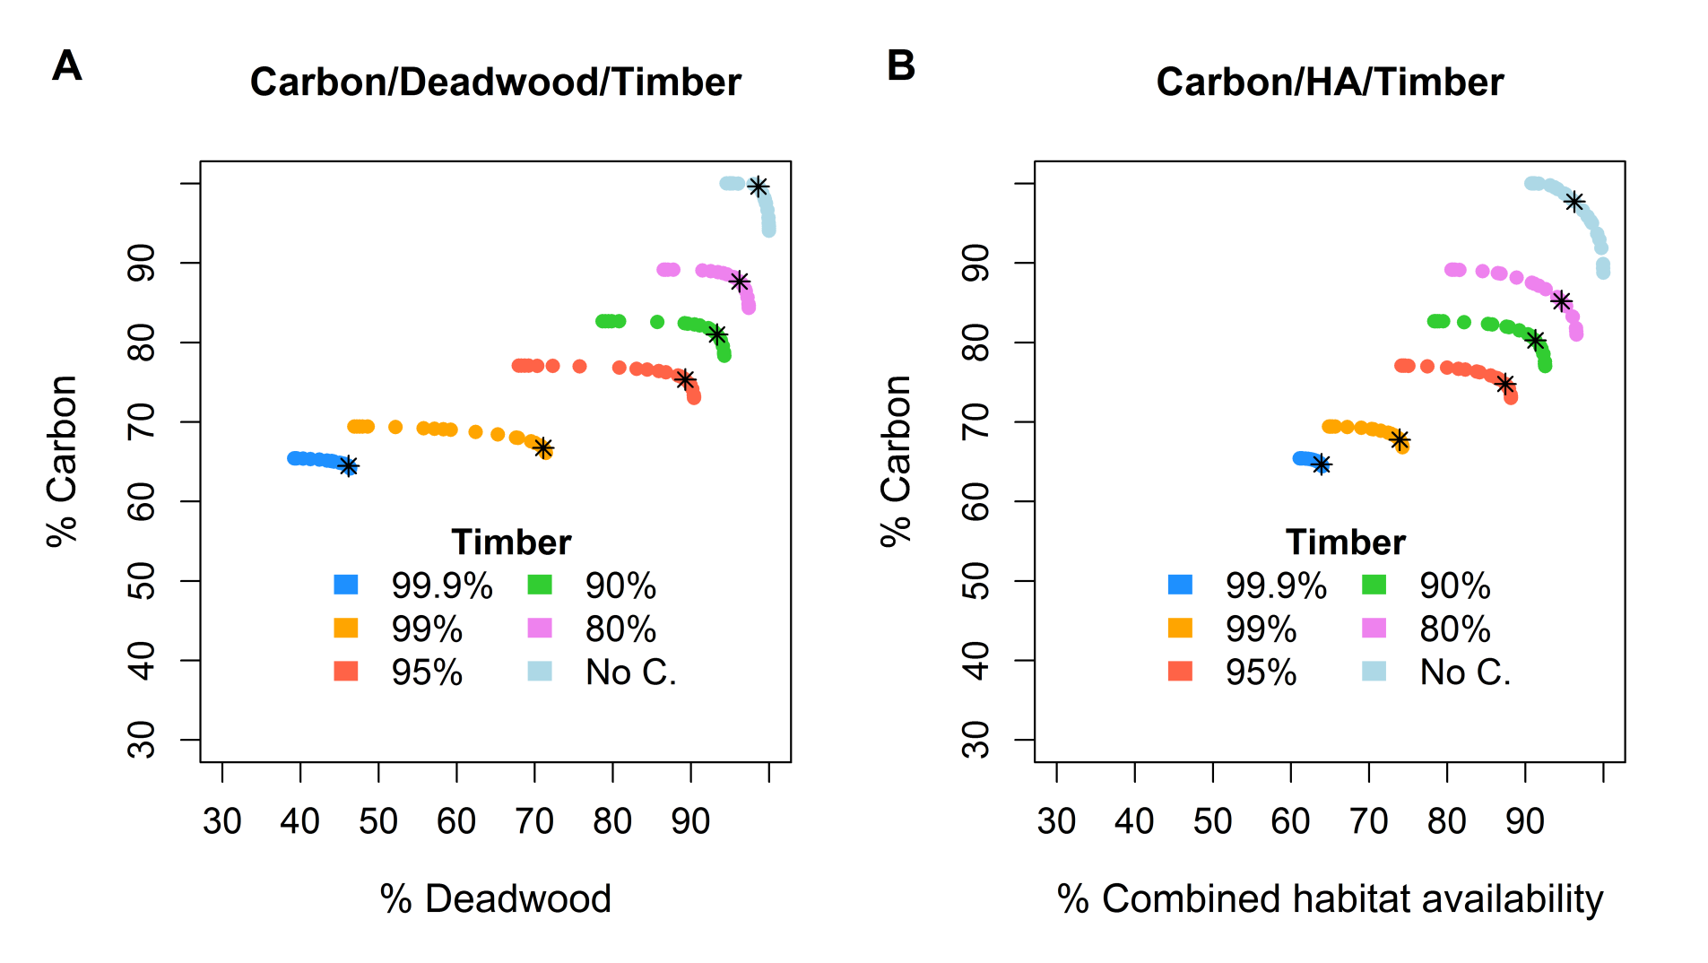
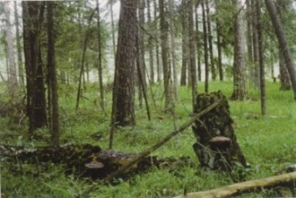
Question 1. Conflicts: How much carbon and deadwood is possible to obtain given different levels of timber revenue?
.
It is not possible to have high levels of deadwood and ecosystem services when the objective is to maximize timber.
Therefore, it is not possible to have a multifunctional landscape when the only aim is to maximize timber.
By giving up some small levels of timber is possible to greatly increase the landscape multi-functionality.
.
Triviño et al, 2017. Optimizing management to enhance multifunctionality in a boreal forest landscape. Journal of Applied Ecology 54:61-70.
Notes:
With NO CONSTRAINTS achieves 3–29% of the maximum NPV value

Slide 56
Question 2. How much carbon and habitat for different species is possible to obtain given different levels of timber revenue?
Again, it is not possible to have high levels of habitat availability and ecosystem services when the objective of forest management is to maximize timber NPV.
However, the conflicts between habitat availability, carbon and timber are less severe than for deadwood.
Notes:
With NO CONSTRAINTS achieves 3–29% of the maximum NPV value

Slide 57
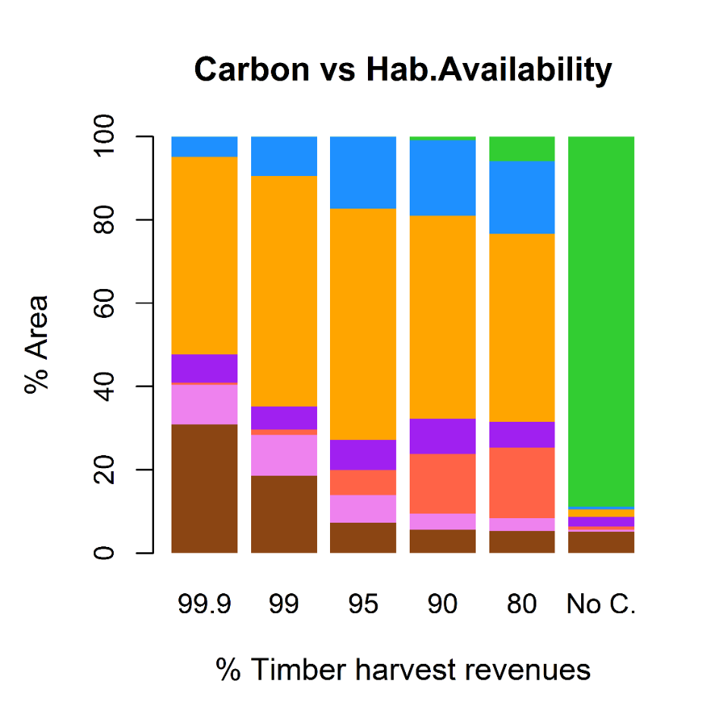
Question 3: What is the optimal forest management regimes for different levels of timber harvest revenues?
.
It is surprising that the proportion of the recommended BAU is very low (30%), even when the aim is to maximize timber.
The proportion of the regime No thinnings & short rotation (NTSR) was the highest for all levels of timber. Exception: when no constraints, then set-aside (SA) was around 90%
Forest regimes:

Slide 58
Conclusions
Using forestry planning systems and models for indicators of ES and biodiversity we can study large-scale and long-term trade-offs and synergies
There is a well-known conflict between managing for timber and biodiversity. However, with careful management planning and accepting only a small decrease in revenue from timber potentially much increase deadwood availability and biodiversity
Surprisingly, maximum revenue from timber where obtained with only 30% of the landscape managed as BAU. This management is currently very dominant in Fennoscandia
Triviño, M, Pohjanmies T, Mazziotta A, Juutinen A, Podkopaev D, Le Totorec E, Mönkkönen M. 2017. Optimizing management to enhance multifunctionality in a boreal forest landscape. Journal of Applied Ecology 54:61-70.

Slide 59
Thanks for your attention

