Slide 1


Governance of Exclosures: Practices and Performances of bylaws Evidence from Tigray Region, Ethiopia
Dawit Gebregziabher, Arezoo Soltani & Ole Hofstad
IUFRO Summer School 2017
15.09.2017

Slide 2
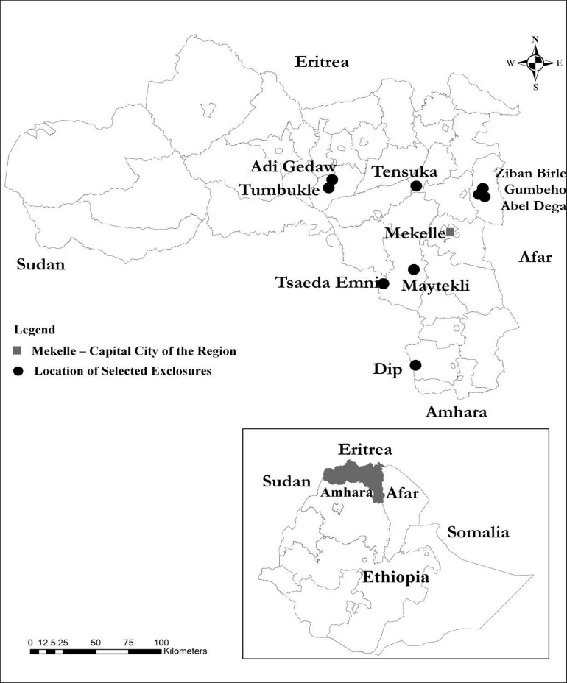
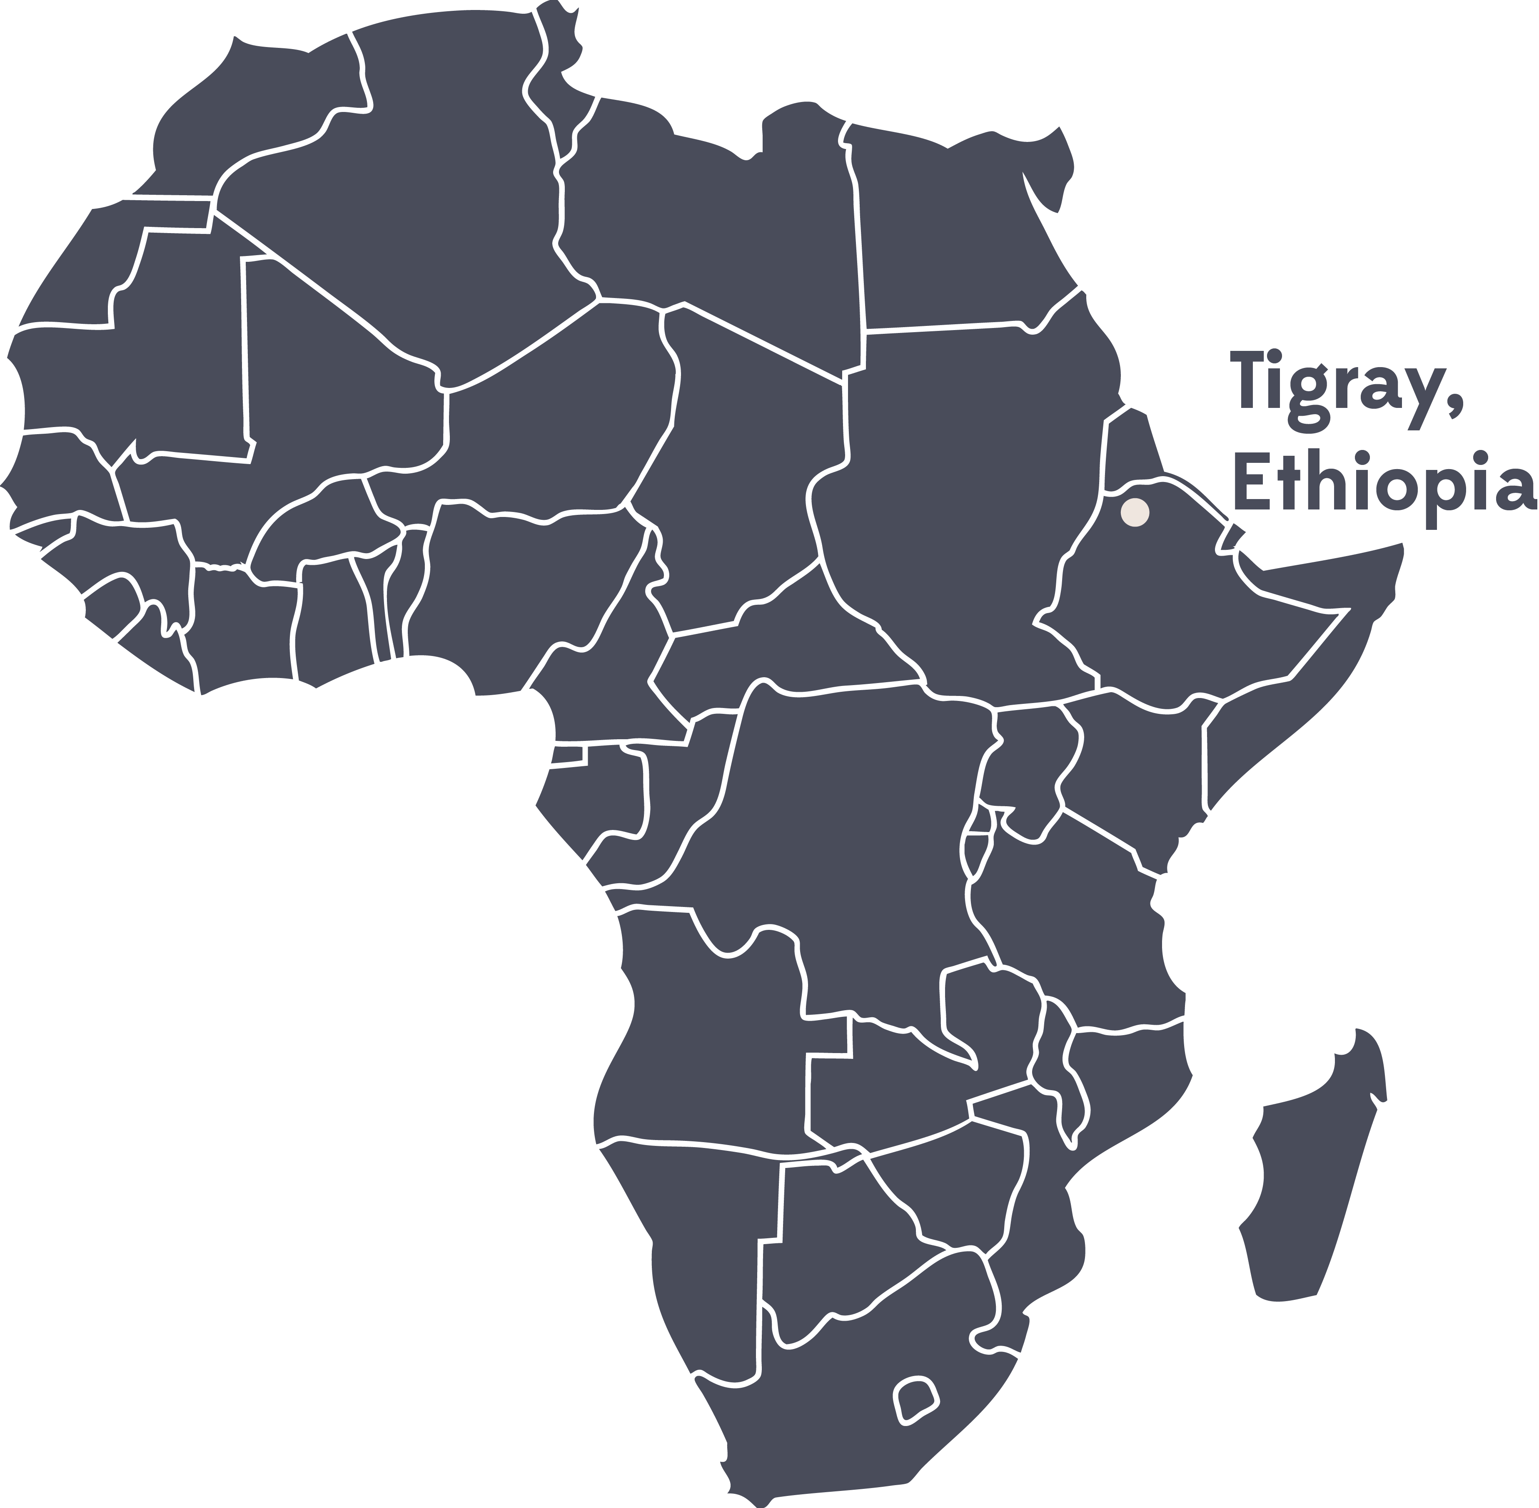
Study site
    Figure 1. Locations of the selected exclosures in Ethiopia and the Tigray Region

Slide 3
Research problem
The focus on the current study is to provide the realities that existed at the ground level but hardly reported in the literature using case studies.

Slide 4
Case studies
The case studies in this paper are mainly focusing on the following issues:
Story on how the idea of exclosure was communicated with the local farmers
Management of exclosures and protected areas (Hizaeti) by the local farmers
Special case about an exclosure that was established on cropland
Emerging role of exclosures as income generating ventures for the landless youth: Opportunities and challenges

Slide 5
How was the idea of exclosure communicated to the local community? The case of Tensuka
    Flood problem
    Land degradation
    Importance of land rehabilitation
    Elderly people and Tabia administration
    80% of the participants agreed with the idea

Slide 6
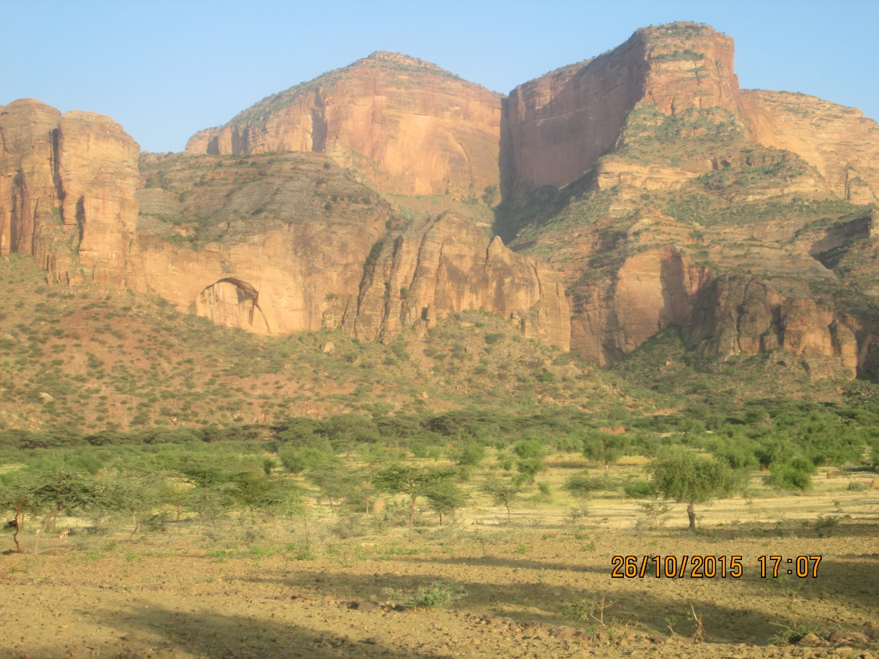
Tensuka Exclosure

Slide 7
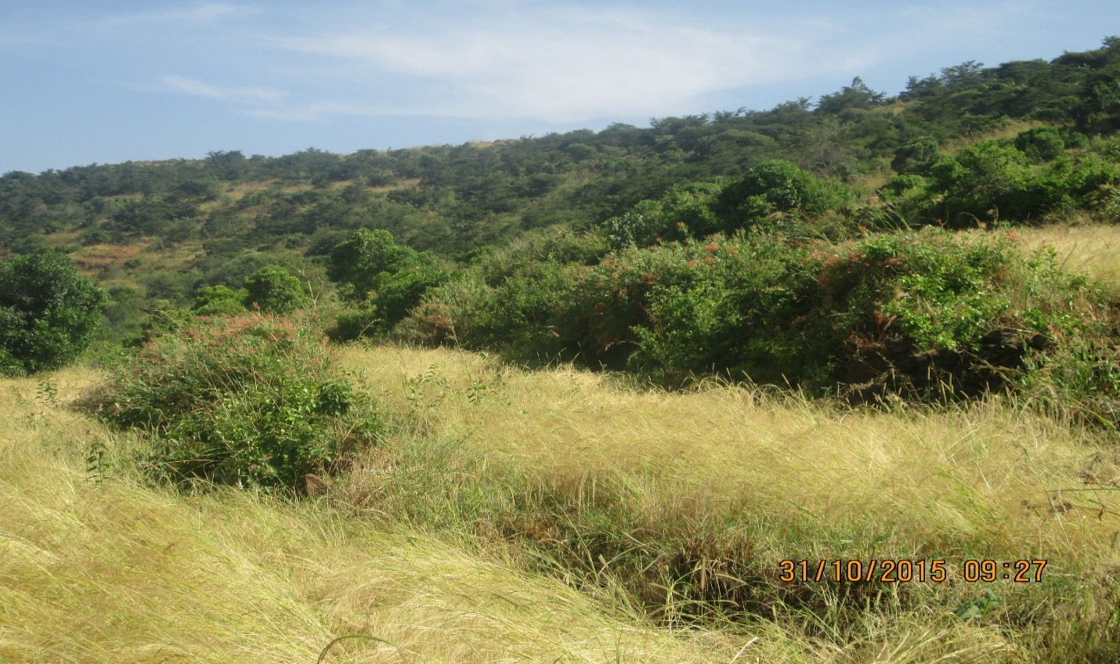
Case study on exclosure that was established on cultivated land
Adi Gedaw Exclosure, an exclosure established on farmland

Slide 8
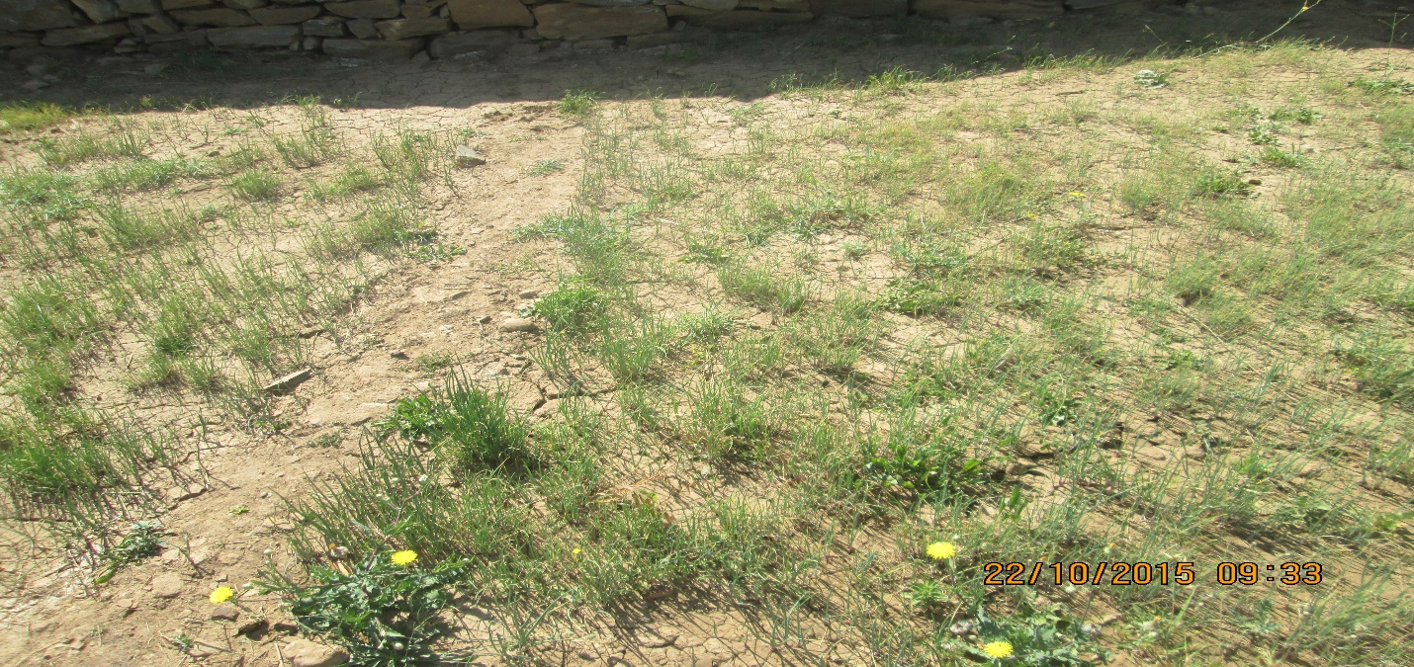
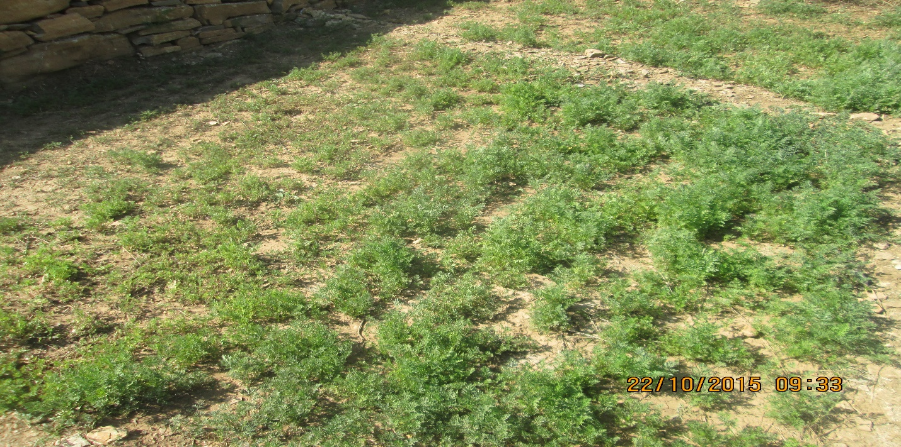
Exclosures as emerging income generating ventures for the landless youth in Tigray, Ethiopia
Red onion seedlings
Carrot plantation

Slide 9
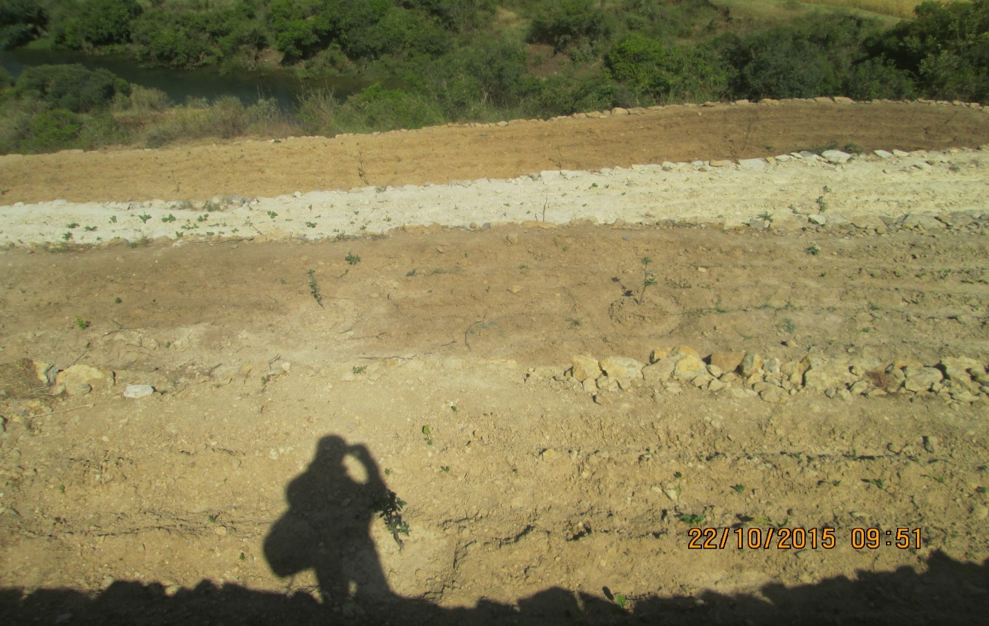
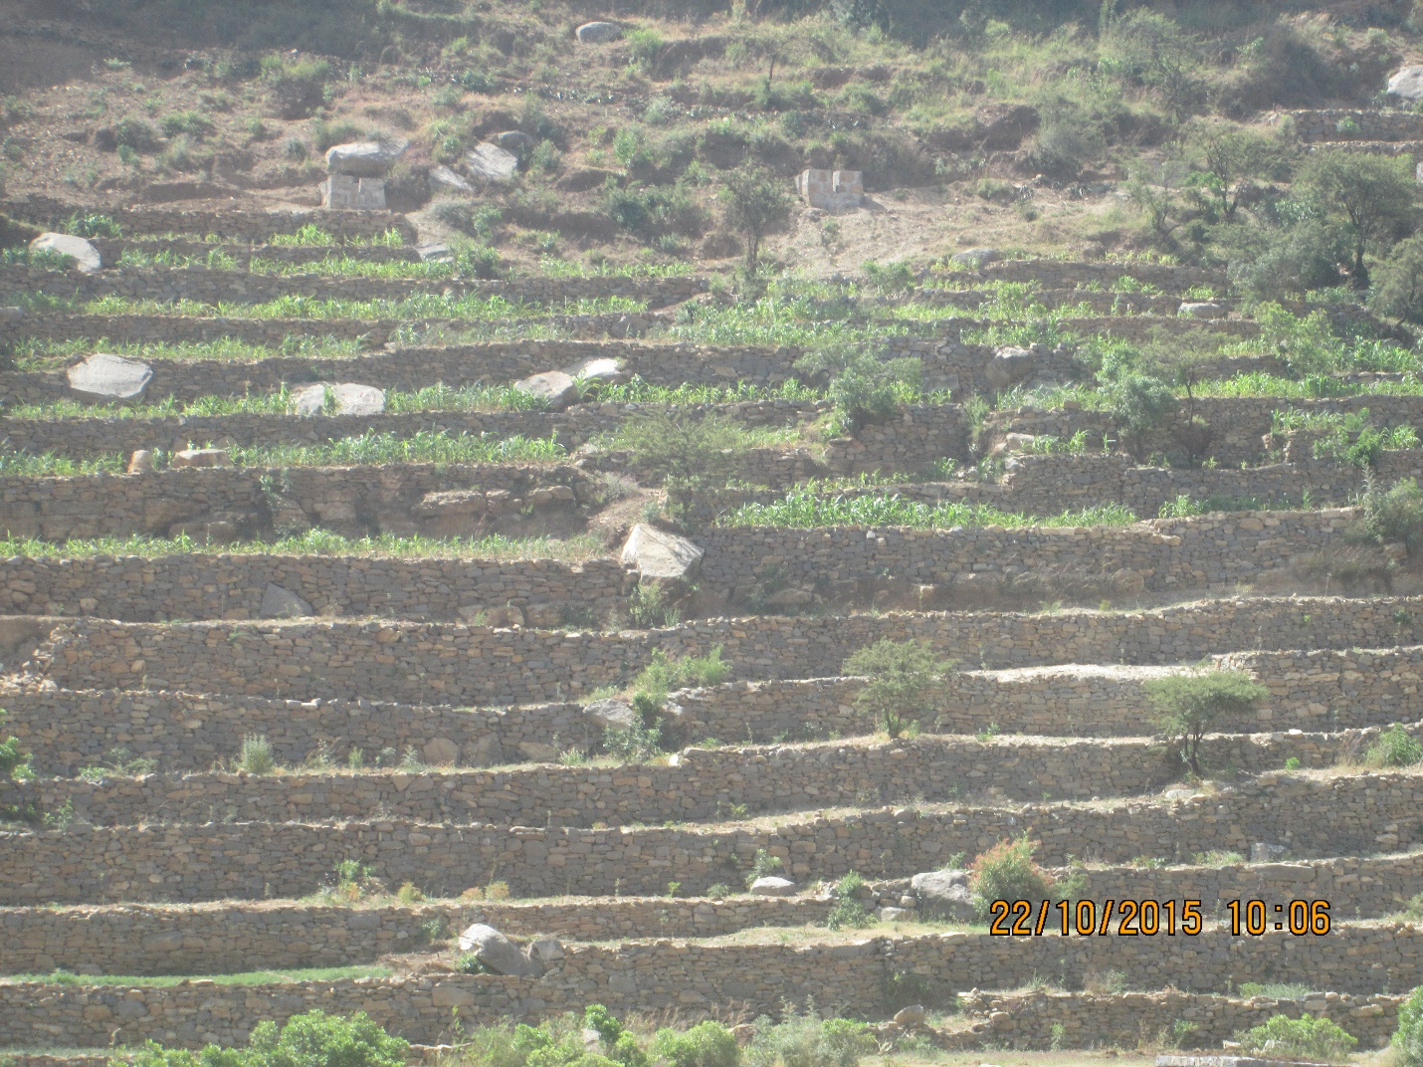
Apple plantation
Series of stone terraces covered with annual and perineal plants

Slide 10
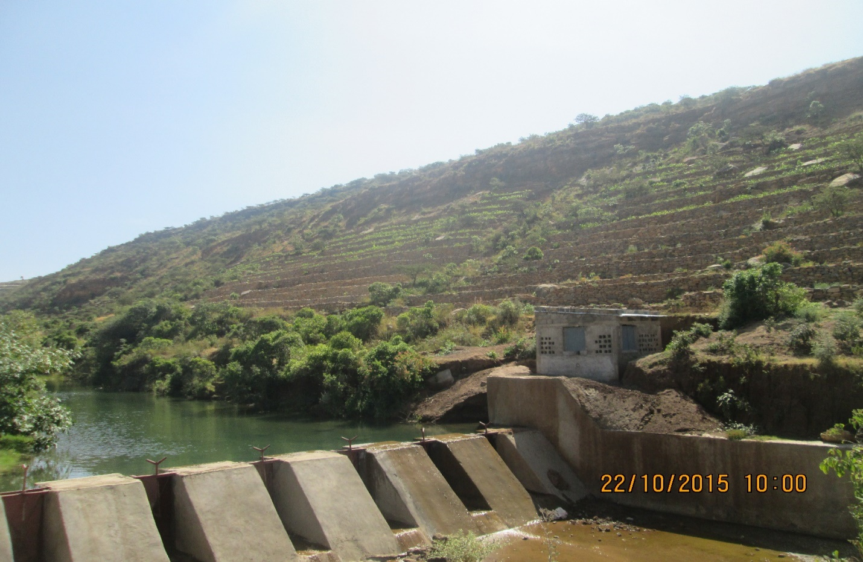
Water source for the plantation and house for the generator

Slide 11
“Ethiopia's Tigray Region got gold award for greening its drylands”
“Ethiopia’s Tigray Region Conservation-Based Agricultural Development-Led Industrialization supported by Mass Mobilization Campaigns and Youth Responsive Land Policy More people less erosion” World future council, 2017

Slide 12
Lesson learnt from walk and talk
My mentor was Andy
Comments forwarded from my mentor
To state research questions (I included it after I submitted the paper)
To use the design principles of Ostrom
To deal with property right and participation issues
To consider the idea of commons and anti-commons
How to make the manuscript more scientific
Moreover, he is willing to read the manuscript after I incorporate the comments

Slide 13
Acknowledgments
International Research School in Applied Ecology (IRSAE) for providing me part of the mobility grant to attend this course
Norwegian University of Life Sciences
(main supervisor: Prof.Ole Hofstad)
IUFRO summer school 2017 organizers
Group leaders and members of mixed method and all other members
My mentor: Andy

Slide 14
Thank you for your time and attention!

